Slide 1
Long baseline interferometry in the visible:
Recent progress on FRIEND project
Marc-Antoine Martinod
Denis Mourard, Karine Perraut, Philippe Berio, Jean-Michel Clausse, Anthony Meilland, and CHARA staff
CHARA Meeting – March 2016

Slide 2
Outline
Short presentation of FRIEND prototype
Coupling efficiency and limiting magnitude
Instrumental visibility
Closure phase
Adaptive optics and injection
Notes:
Remplacer Recap par short presentation of FRIEND prototype

Slide 3
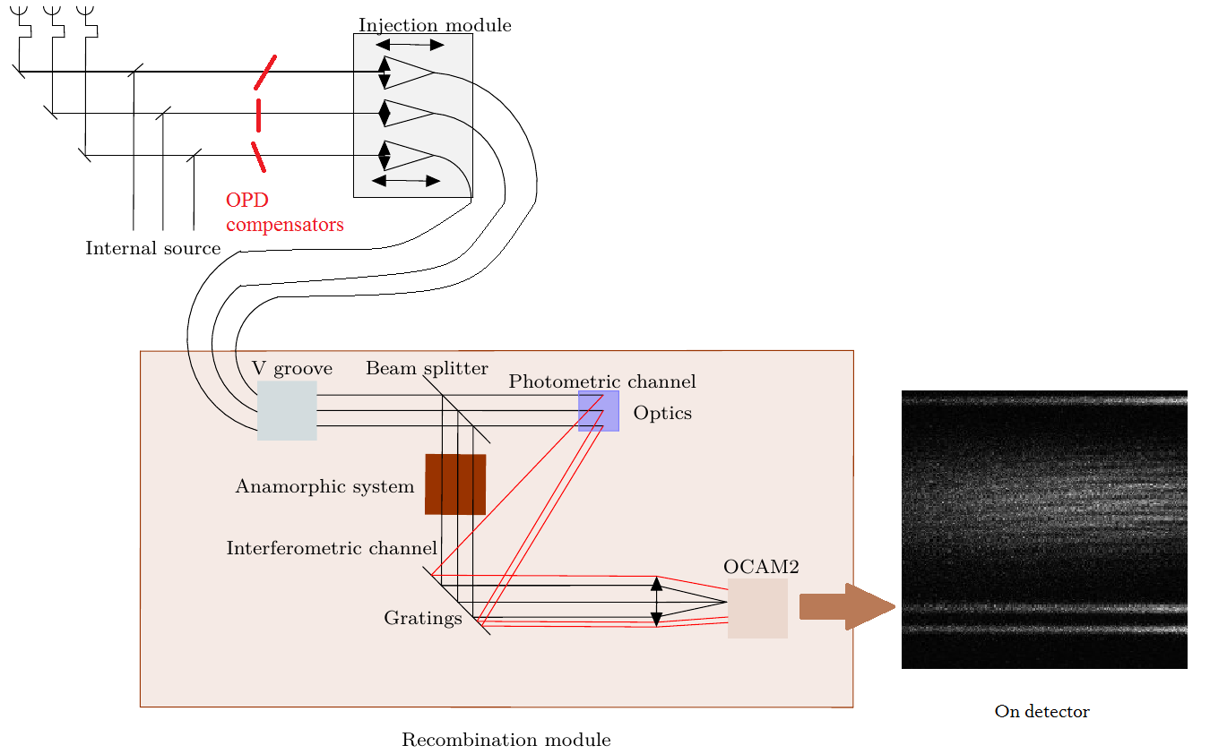
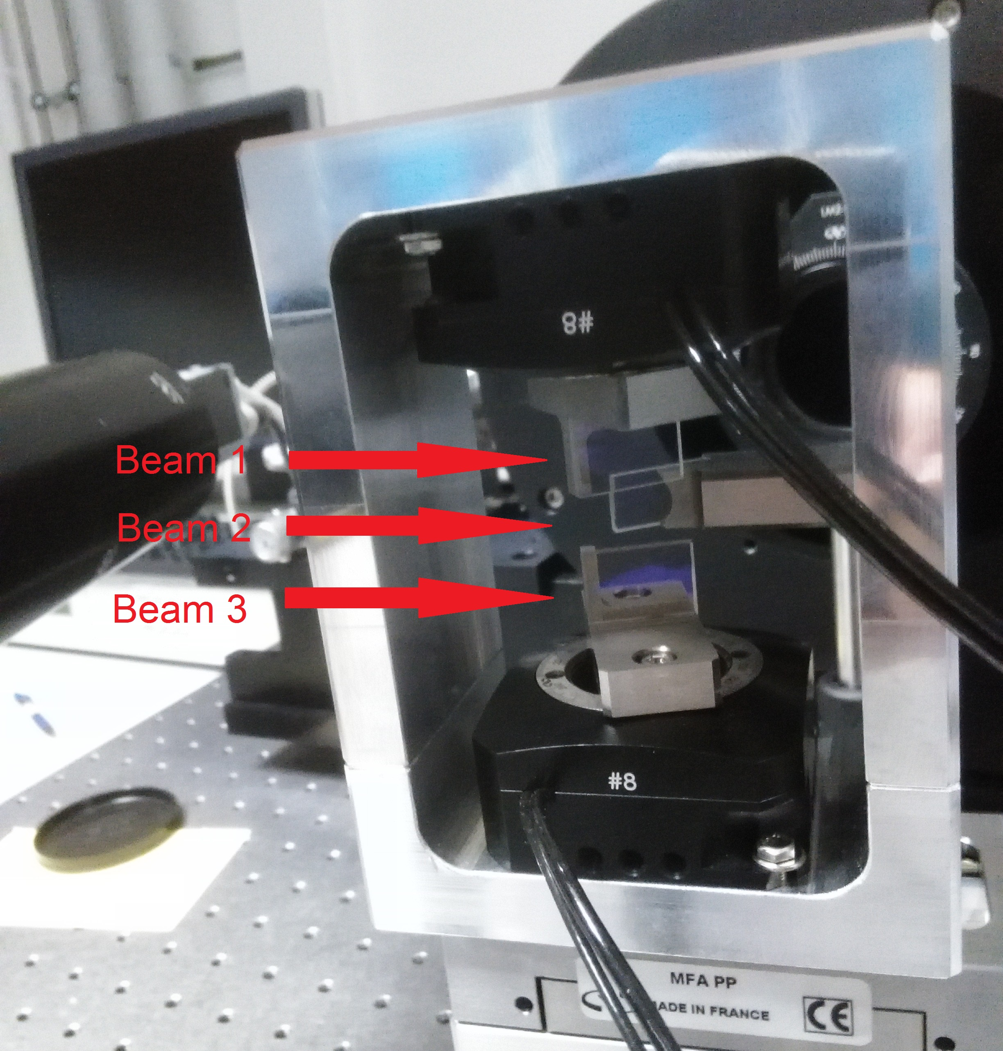
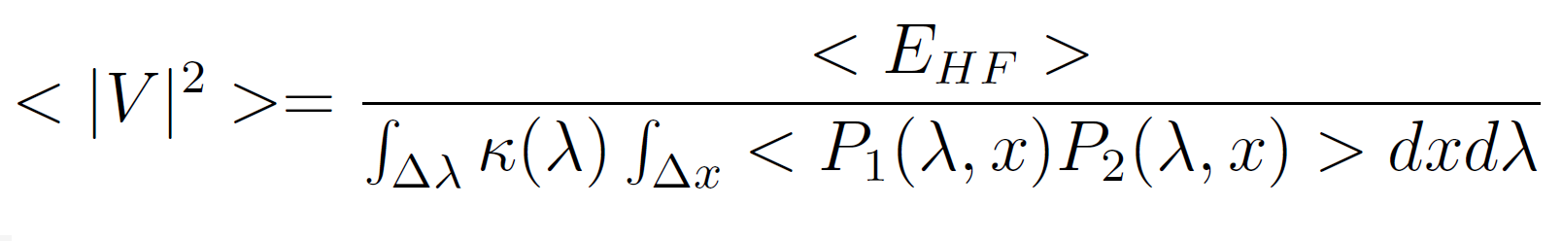
Short presentation of FRIEND prototype
Notes:
Estimator works with averarage quantities !

Slide 4
V 5.076
V 5.076
Observations
2016-09-29
E1E2W2
r₀ = 10 cm
1 Cal:
  HD3360: mR = 3.74
1 Sci:
  HD5394: mR = 2.32
2016-09-30
E1W2W1
r₀ = 14 cm
3 Cal:
  HD3360: mR = 3.74
  HD2905: mR = 4.02
  HD3240: mV = 5.076
2 Sci:
  HD5394: mR = 2.32
  HD11415: mR = 3.4

Slide 5
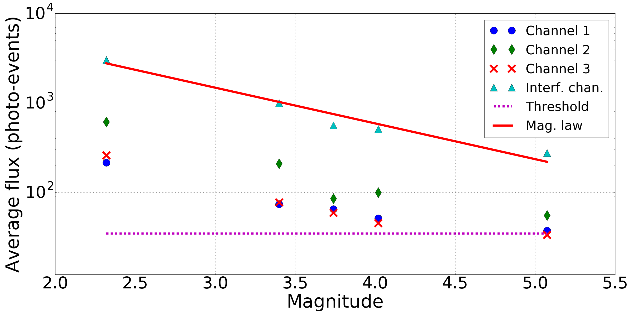
Coupling efficiency and limiting magnitude
Limiting magnitude defined by flux in photometric channels

Slide 6
Coupling efficiency and limit magnitude
r₀ = 14 cm @ 550 nm => ρ_{expected} = 2,6%
Measured flux and magnitude
t_{CHARA} = 1.7%
t_{FRIEND+OCAM} = 31.5%
=> ρ_{estimated} = 2.8% with no adaptive optics
Notes:
Préciser que rho_estimated est issu des varies données du run de septembre

Slide 7
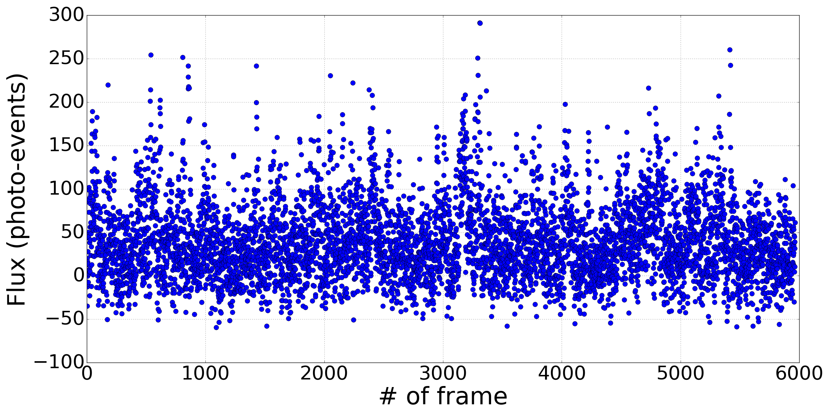

Coupling efficiency and limiting magnitude
Limiting mag defined by photometric channels
For faint stars, flux at 0 or less
Photometric sorting: $P_{i}>n σ_{dark} ,n=1,5$
$mag_{lim}=4.1$
->20~25% of frames
With:
$ρ=2.8\%$
No AO
Notes:
Avec un couplage de 2,8% et sans oA
On dit pas trop low mag mais plutôt faint stars
Mag=4.1 : 20~25% of frames

Slide 8
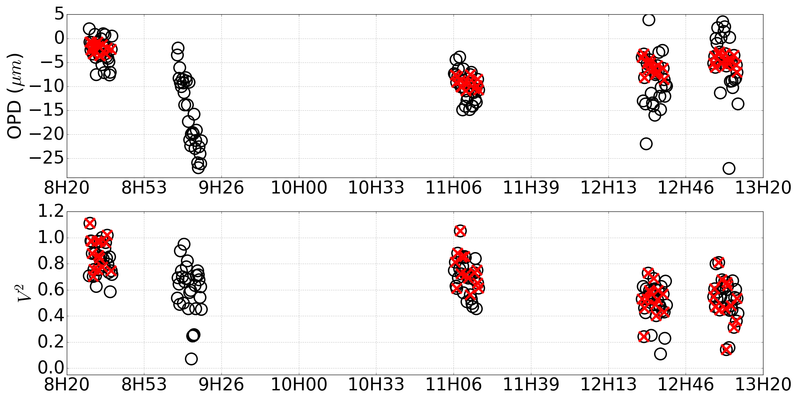
Instrumental visibility
Optimization : OPD rejection method
(low spectral resolution)
Notes:
OPD rejection basse resolution spectrale

Slide 9
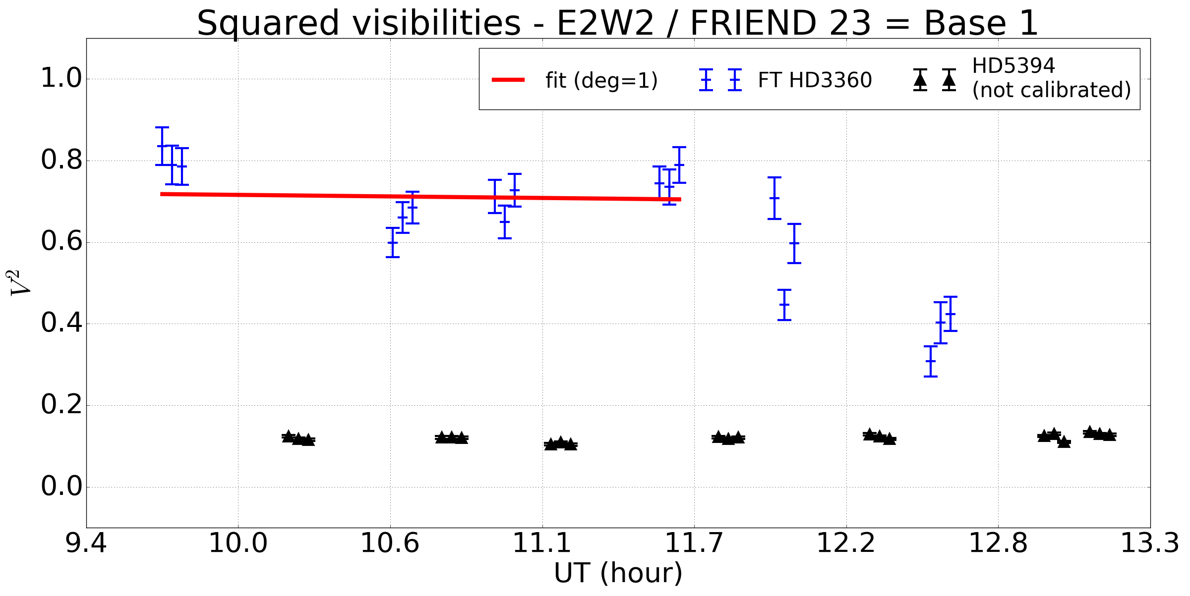
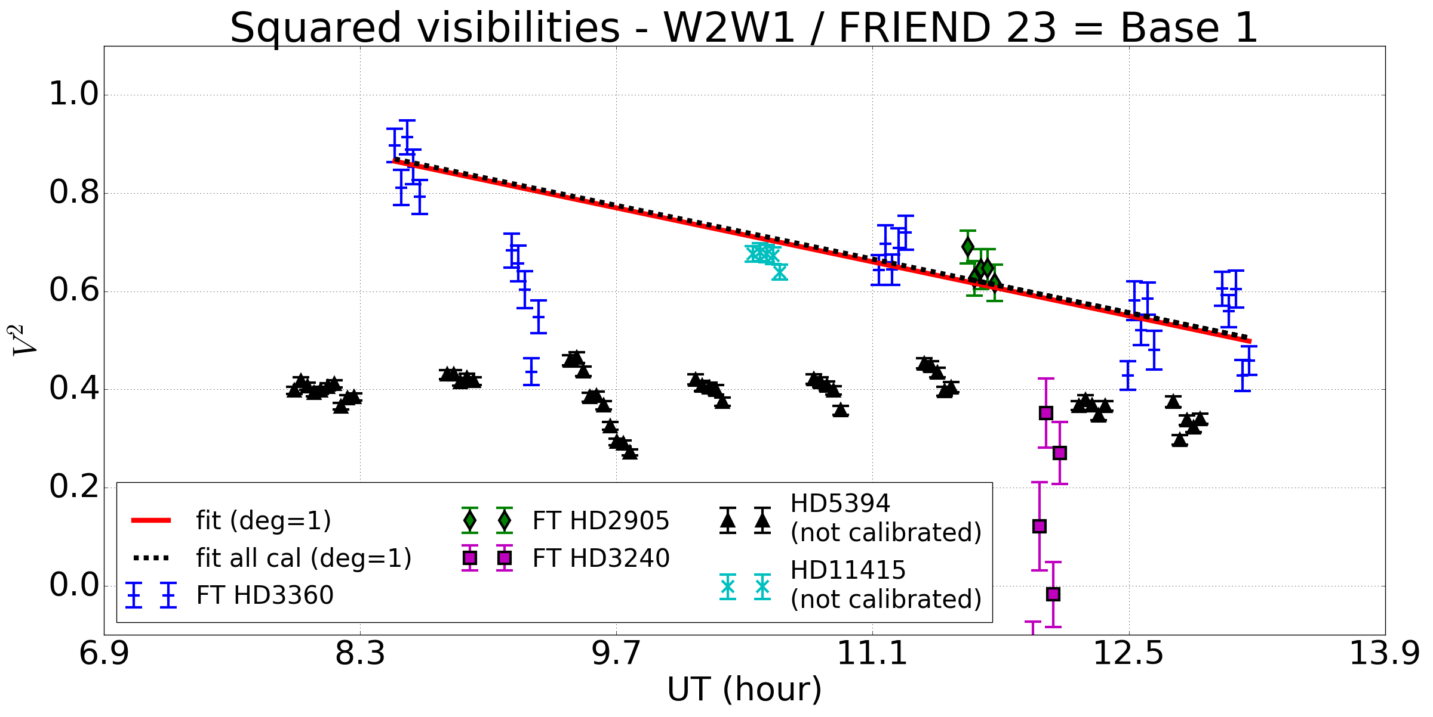
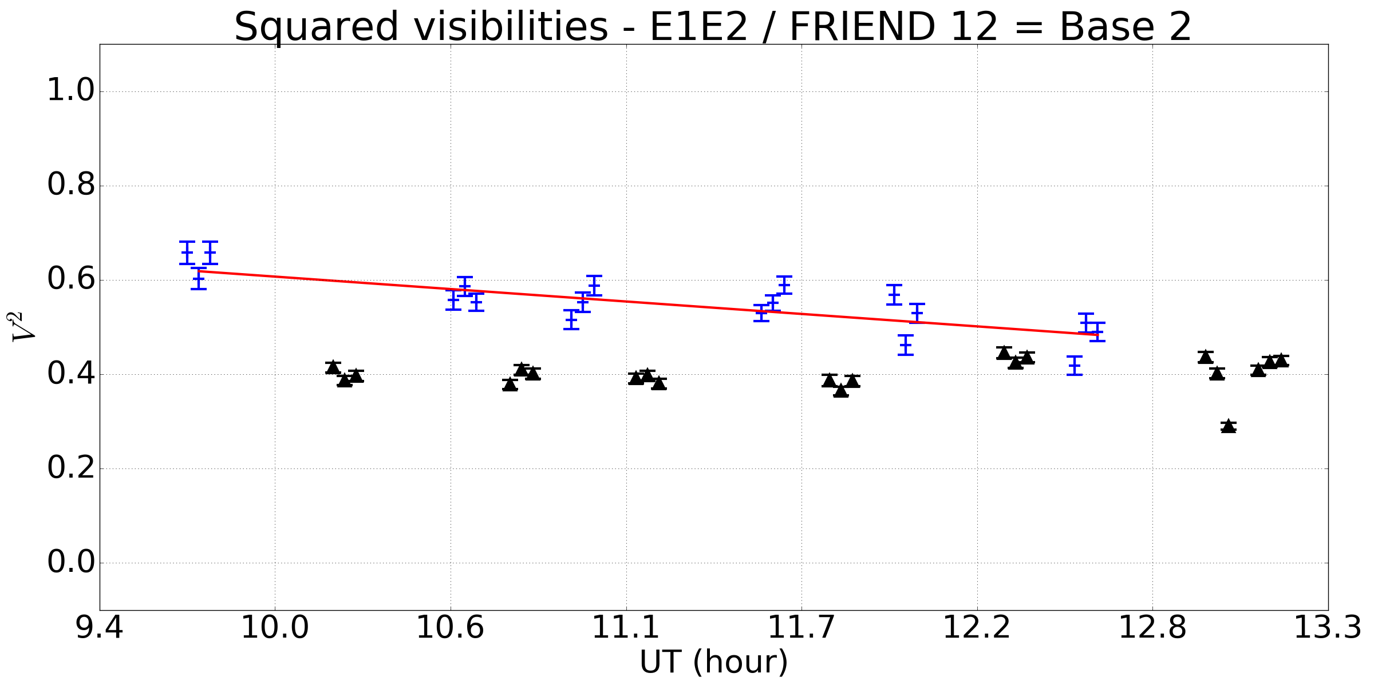
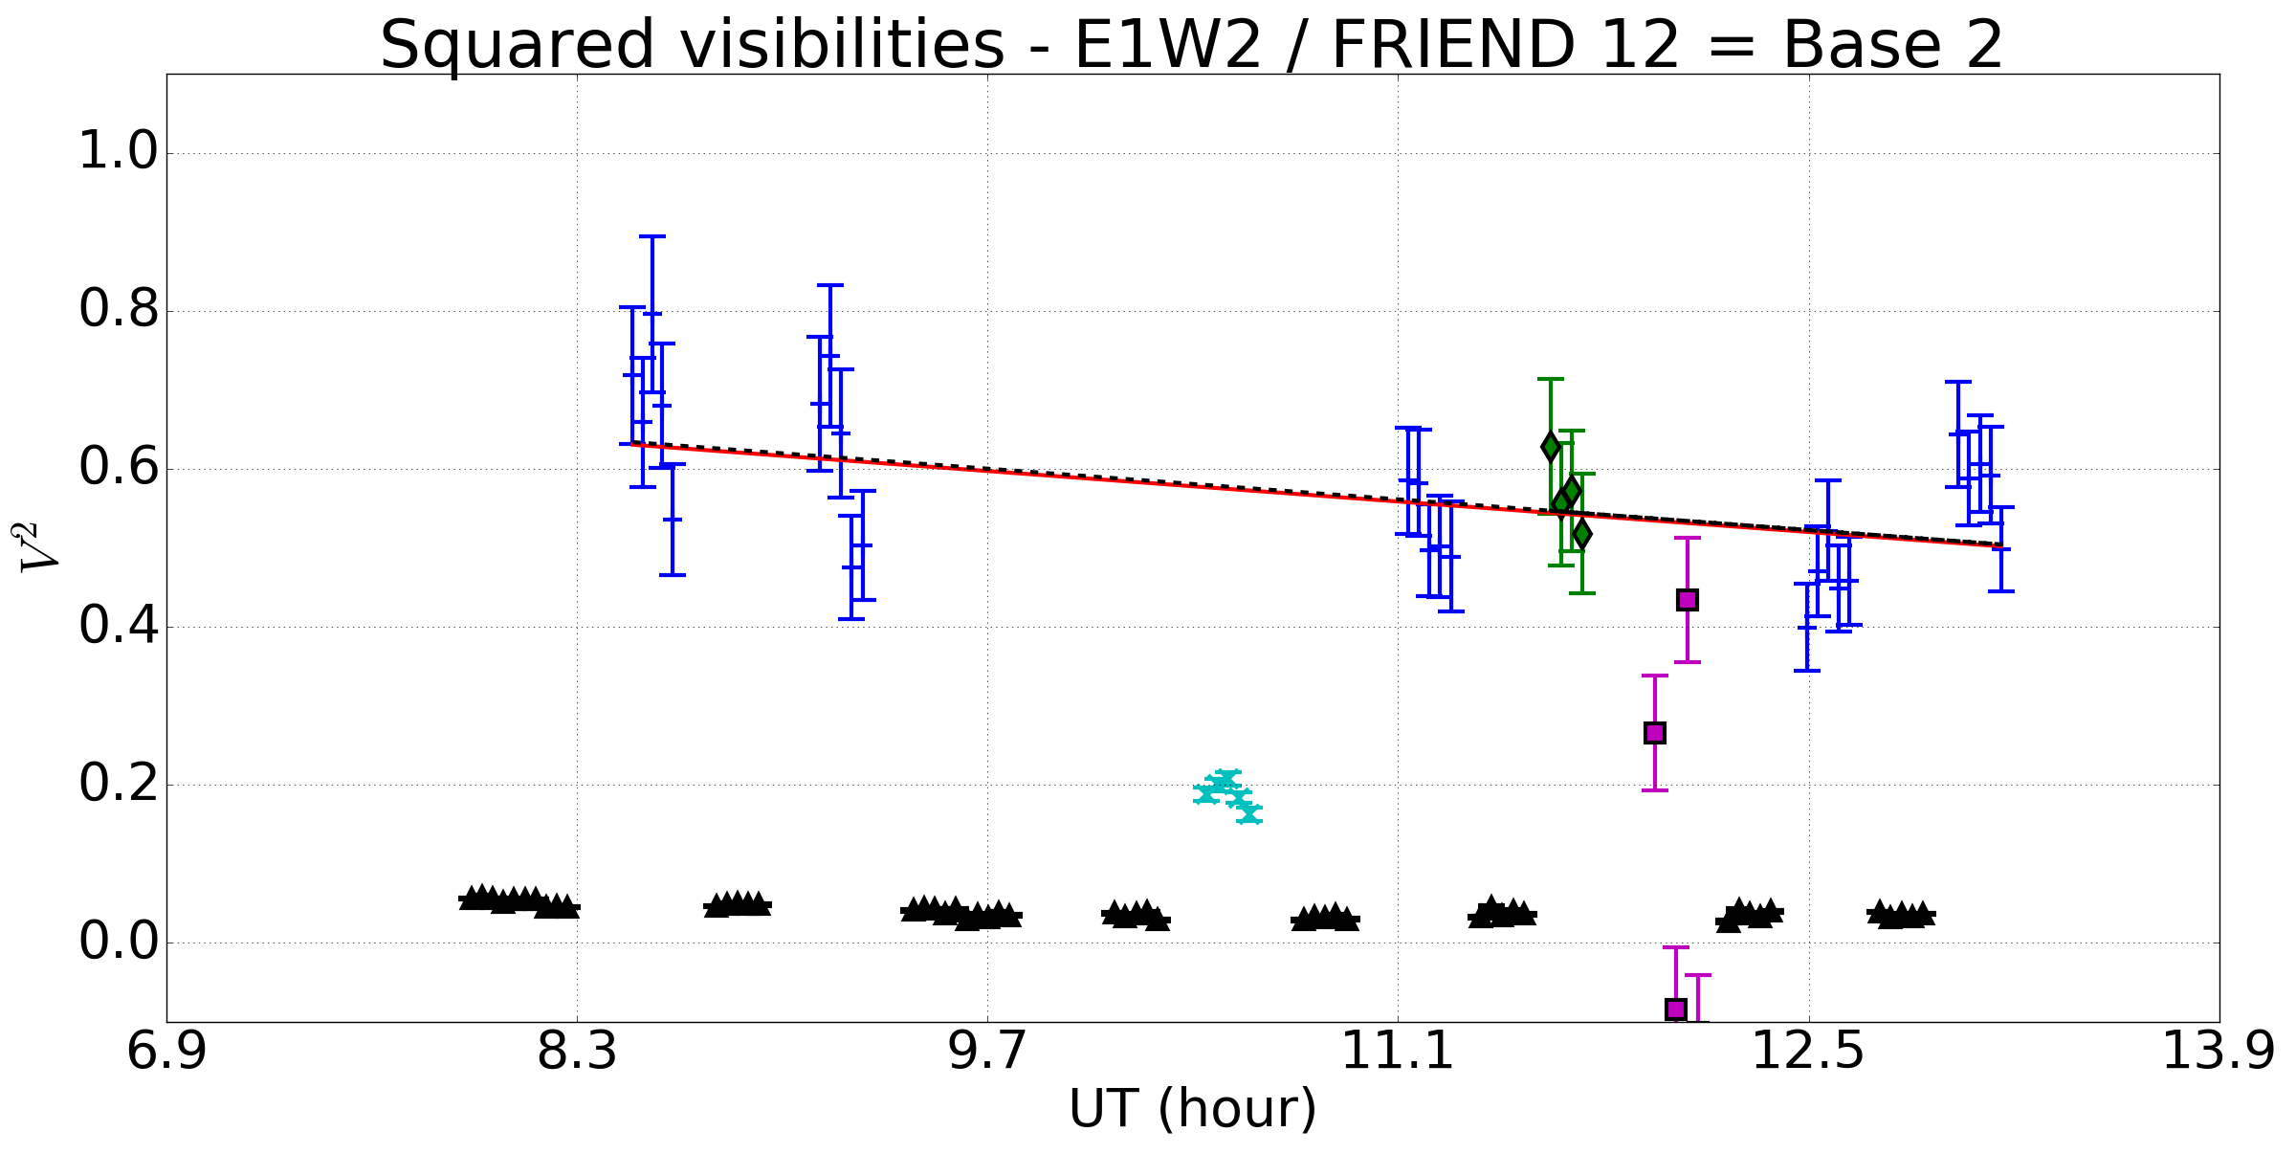
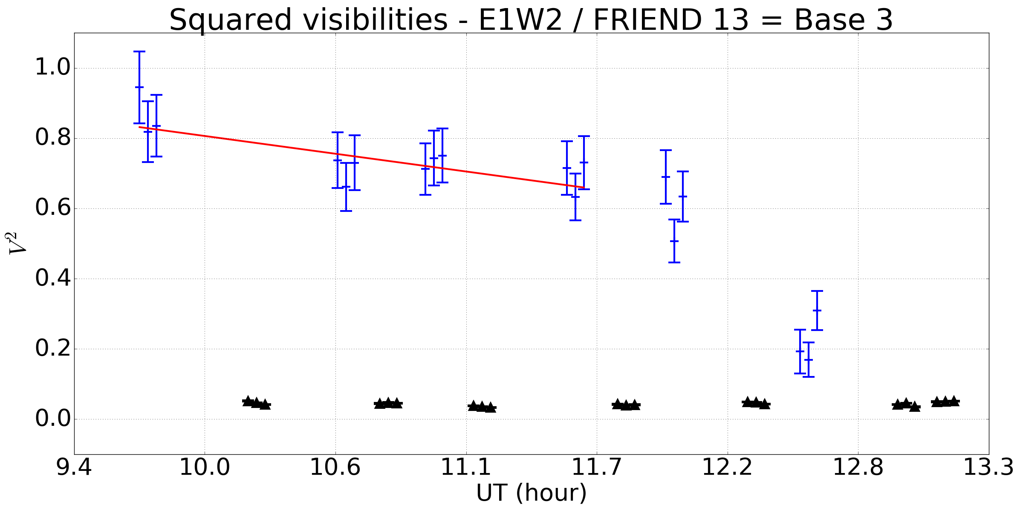
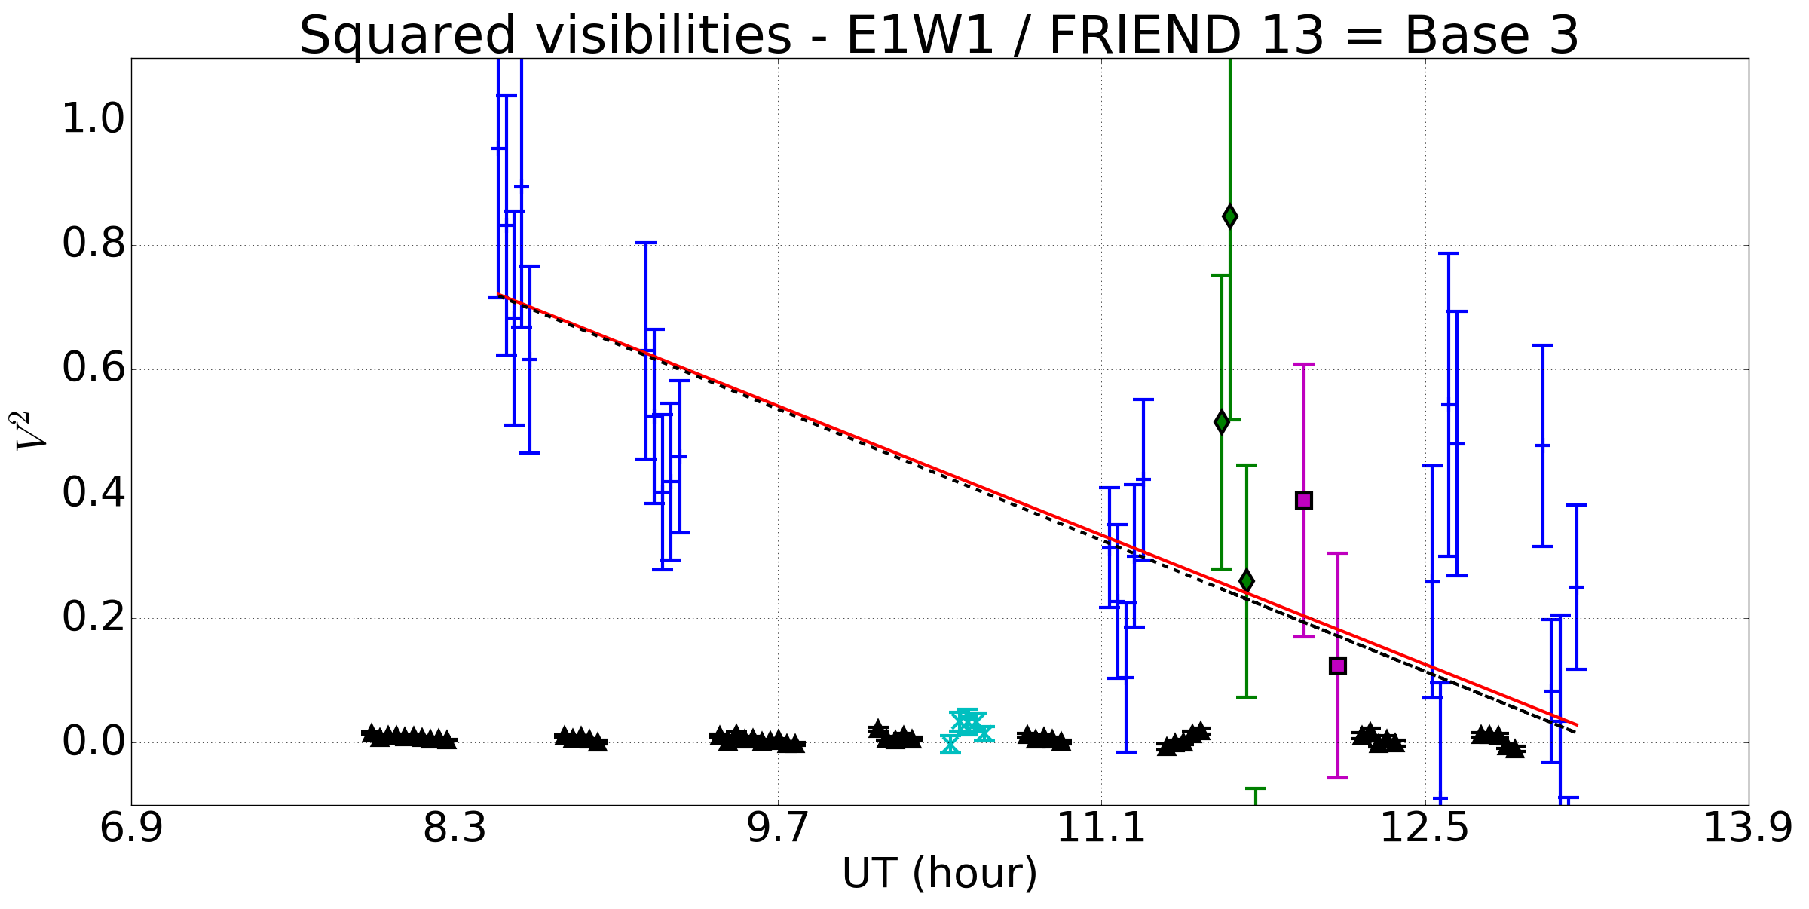
Instrumental visibility
2016-09-29
2016-09-30
Notes:
3 bases

Slide 10
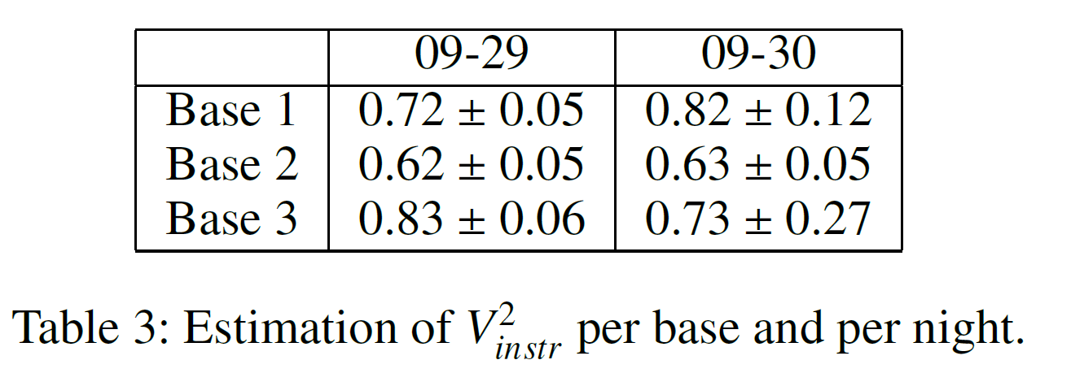
Instrumental visibility
Stability of Base 1 on 09-29
Determination of V_{instr} stable with or without HD2905 (relative variation between fits < 1%)
V_{instr} does not seem night-dependent

Slide 11
Instrumental visibility
Decrease on other bases: due to alignment drifts of pupils ?
Stability with respect to atmospheric condition:
  No strong variation of the seeing during and between the nights
  Systematic errors unseen ?
  Keep investigating
Notes:
Atmosphere : à approfondir
En plus du pupil drift il faut certainement se poser la question de l’injection. Est-ce qu’elle a été suffisamment controlée à chaque étoile? Non et il le faudrait probablement. Se rappeler qu’on est en train d’apprendre à fonctionner avec un instrument fibré monomode.

Slide 12
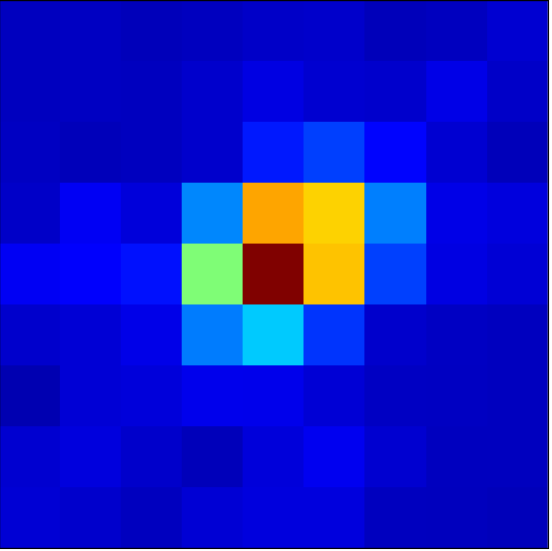
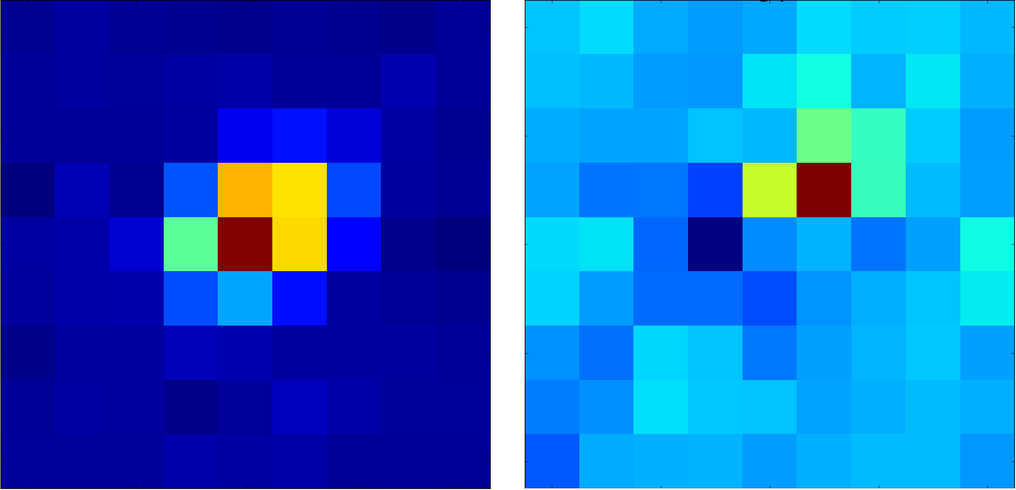
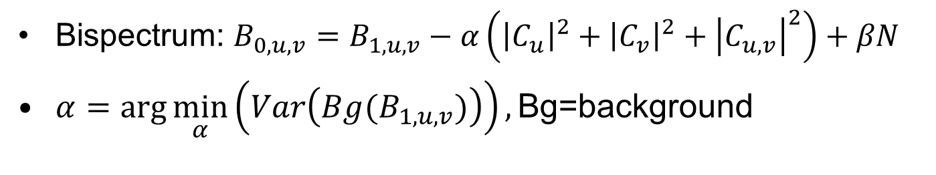
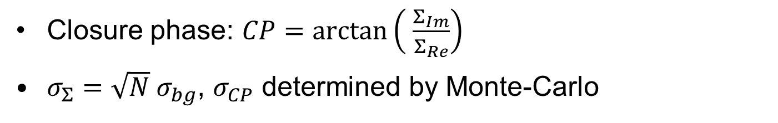
Closure phase
Bispectrum: $B_{0,u,v}=B_{1,u,v}−α\left({\left|C_{u}\right|}^{2}+{\left|C_{v}\right|}^{2}+{\left|C_{u,v}\right|}^{2}\right)+βN$
$α=\arg{\min_{α}\left(Var\left({Bg(B}_{1,u,v})\right)\right),\text{Bg}\text{=}\text{background}}$
Re(B₁)
Re(B₀)
Re(B₀)
Closure phase: $CP=\arctan\left( \frac{Σ_{Im}}{Σ_{Re}}\right)$
$σ_{Σ}=\sqrt{N} σ_{bg}$, $σ_{CP}$ determined by Monte-Carlo
Notes:
Sigma defined by max in modulus

Slide 13
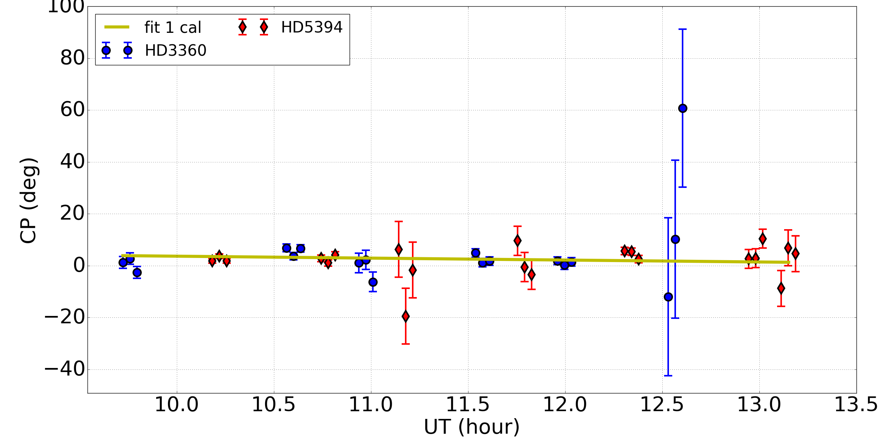
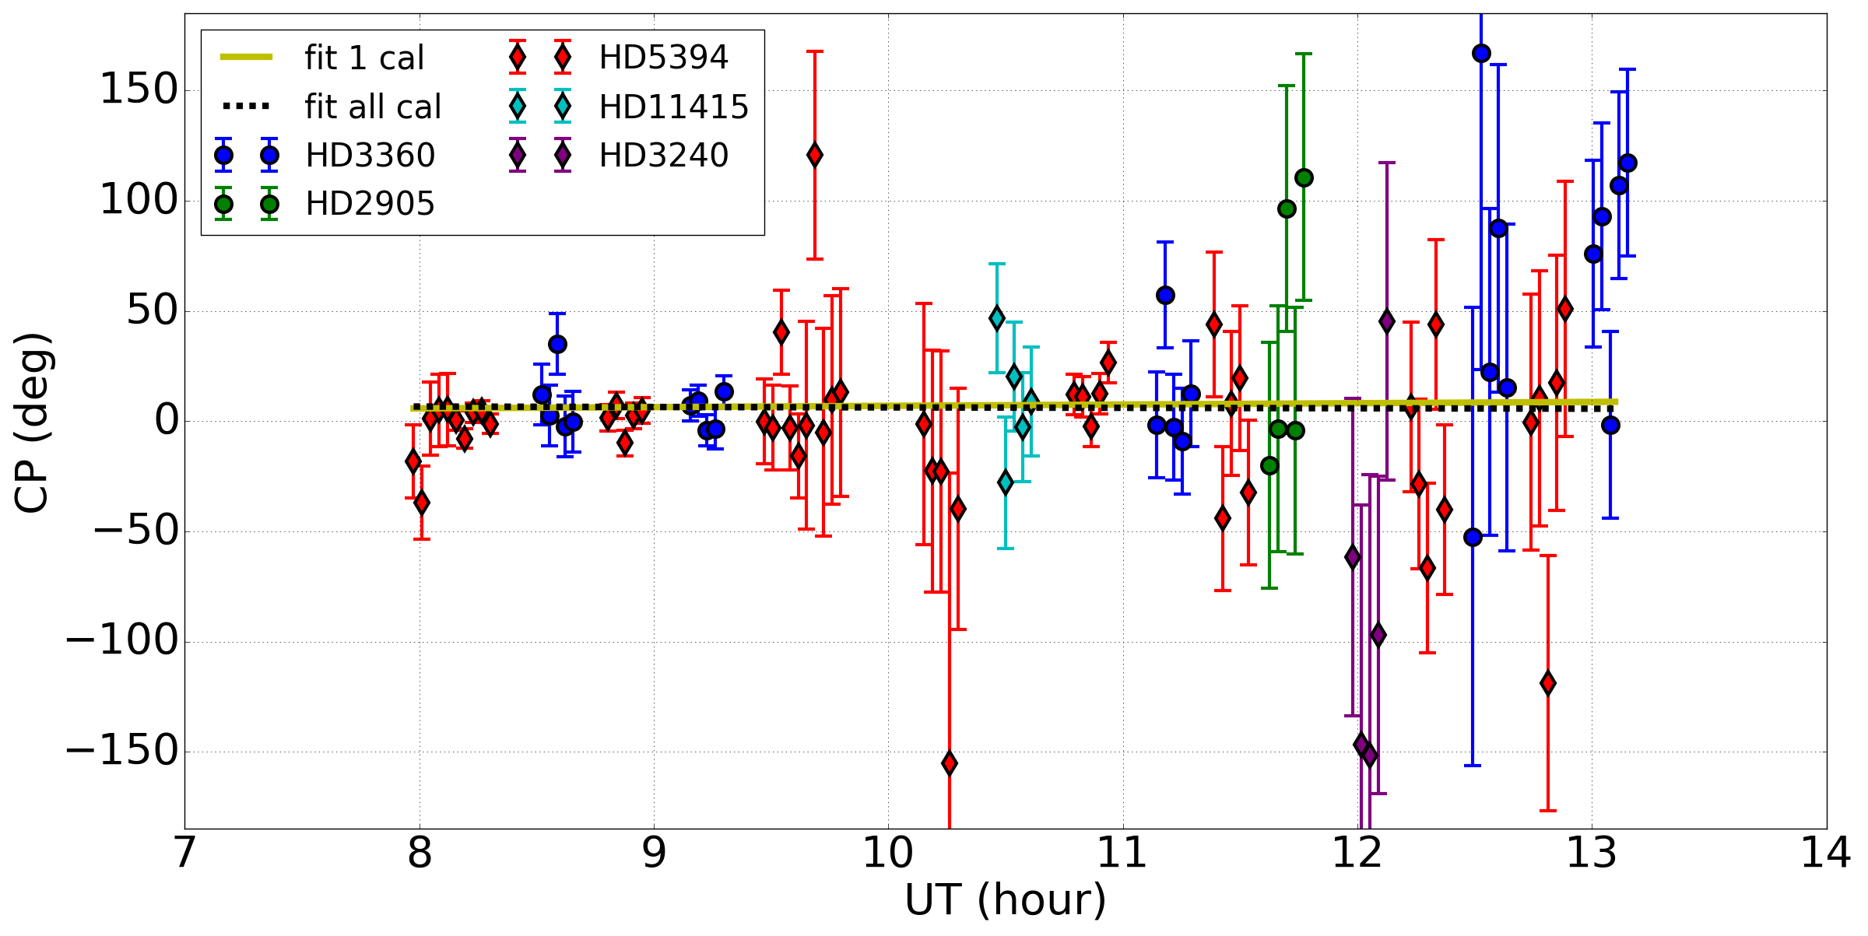
Closure phase
2016-09-29
2016-09-30
Notes:
30/09: réjection de points : 2 derniers blocs de 3360 et 2 pts de 2905
29/09 : 3360 : 7 degrés, 5394 : 4 degrés
30/09: 3360 : 15 degrés, 5394 : 30 degrés
Cela aurait été bien de conserver les mêmes couleurs pour zeta et gamma dans les deux nuits… c’est plus direct à lire. Noir=zeta cas et bleu= gamma par exemple.

Slide 14
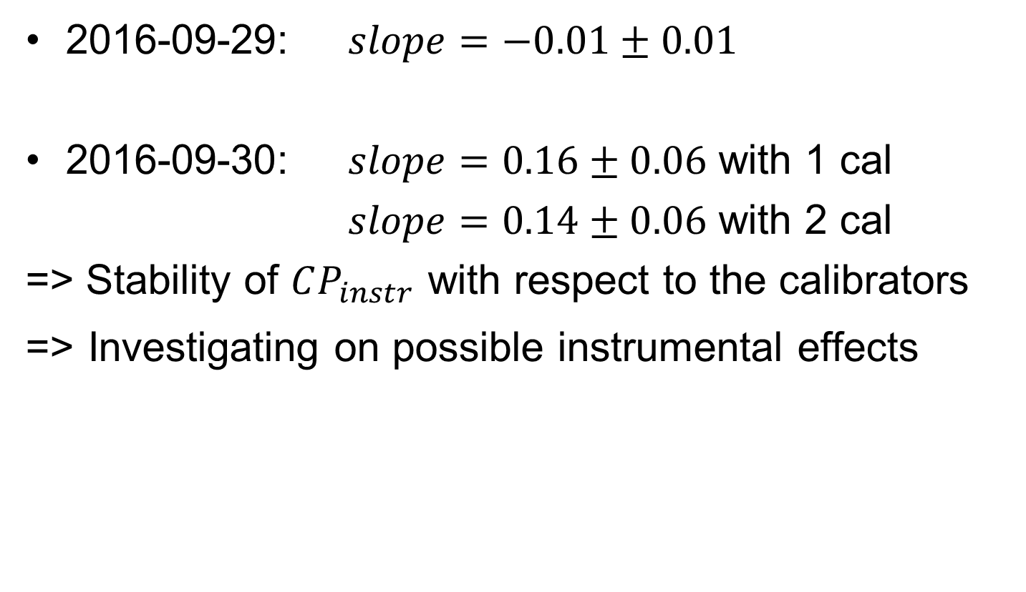
Closure phase
2016-09-29: $slope=−0.01±0.01$
2016-09-30: $slope=0.16±0.06$ with 1 cal
$slope=0.14±0.06$ with 2 cal
=> Stability of $CP_{instr}$ with respect to the calibrators
=> Investigating on possible instrumental effects
Notes:
-0.01+-0.01: tu ne peux pas parler d’une erreur systématique, ce n’est pas significatif. Tu dois dire qu’à 1 sigma c’est stable, un point c’est tout.
Ok par cotnre pour le 30. Et justifier sur d’éventuels effets isntrumentaux en cours d’inevstogation. Pa splus.

Slide 15
Adaptive optics and injection
Observations
(with T.Ten Brummelaar, M.Anderson, J.Sturmann, L.Sturmann, C.Farrington, N. Vargas, VEGA team)
2017-03-08
S2
r₀ = 7 cm
Target: Sirius
AO modes:
  Labao
  Open loop
  Labao + own TT
  Fast TT
2017-03-10
S1S2
r₀ = 8 cm
Target: Procyon
AO modes:
  Labao
  Open loop
Notes:
Préciser: Observations avec Theo, Matt, Judit, Laszlo, Chris and Norm + VEGA team.

Slide 16
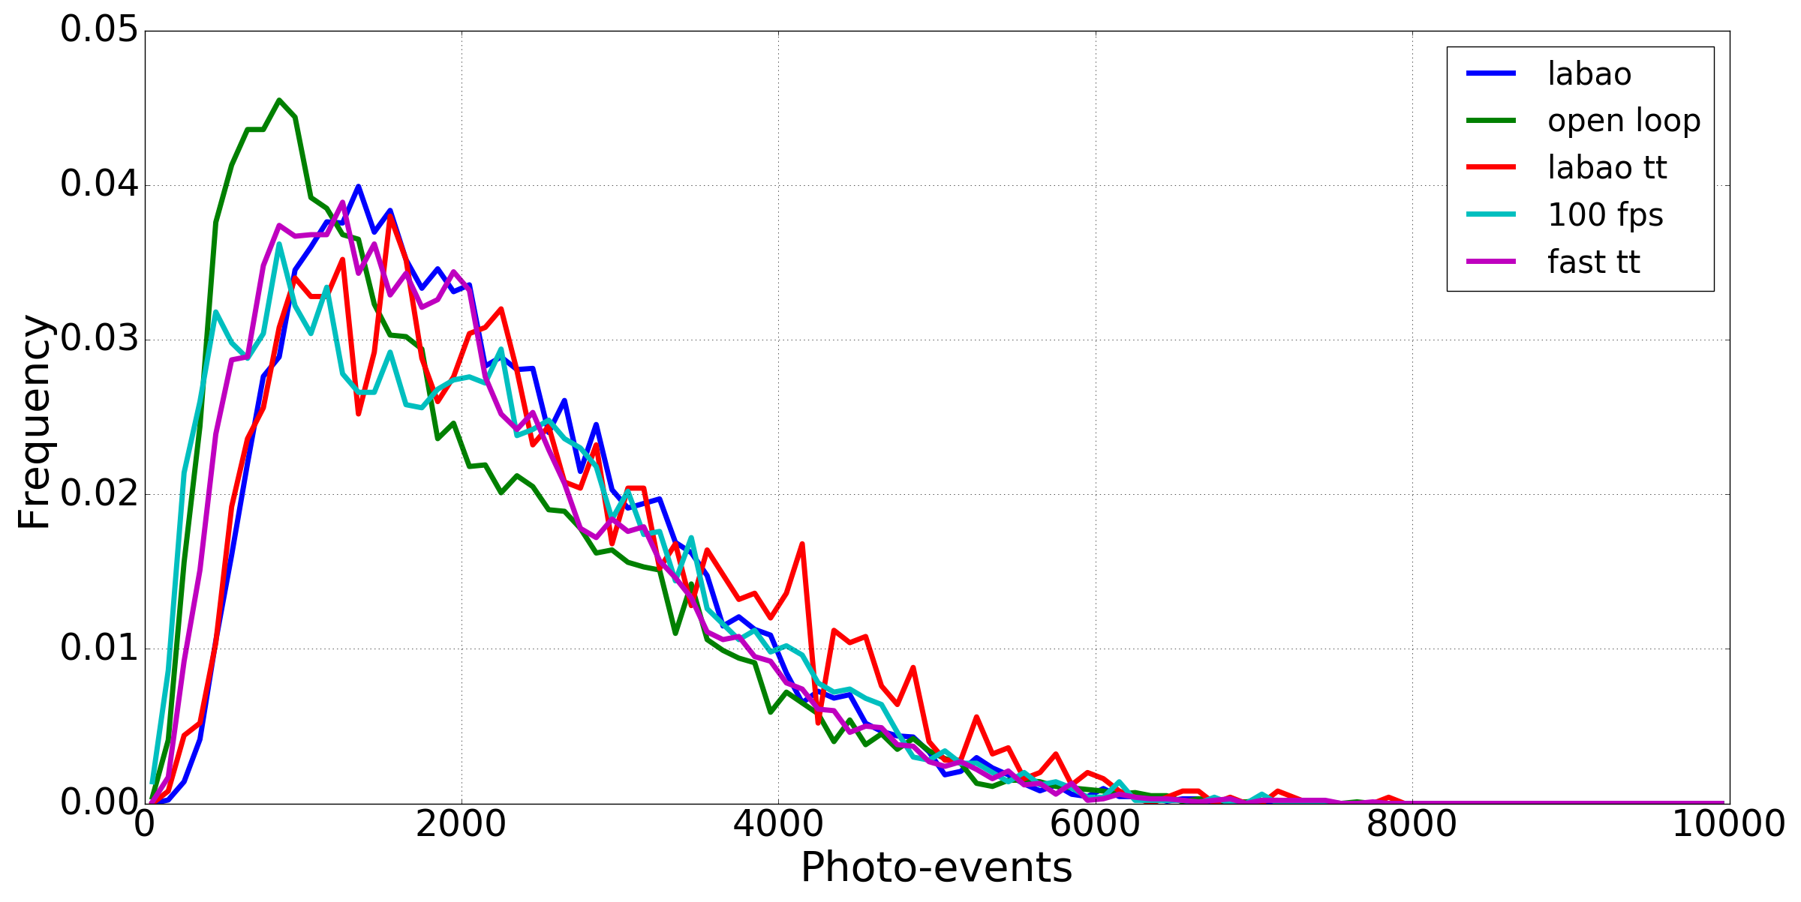







Adaptive optics and injection
2017-03-08
2017-03-10
$$<ρ>_{open loop} =0.65\%$$
$r_{0}=8 cm⇒ρ_{th}=0.88\%$
$r_{0}=7 cm⇒ρ_{th}=0.65\%$
$$<ρ>_{S2,open loop} =0.58\%$$
$$ρ_{labao}=0.76\%⇒$$
$$<ρ>_{S1,open loop} =0.50\%$$
$$r_{0,eq}=7.43cm$$

Slide 17
Conclusion and prospects
Limiting magnitude: characterized and quantified
Instrumental visiblity:
  Stable with respect to magnitude and night-dependent
  Very sensitive to pupil drifts?
Closure phase:
  First measurements of CP quite accurate
  Keep characterizing (magnitude, AO)
AO and Injection:
  AO improves a bit injection in FRIEND
  Correlate FRIEND and AO data
Martinod et al 2017 in prep.

Slide 18
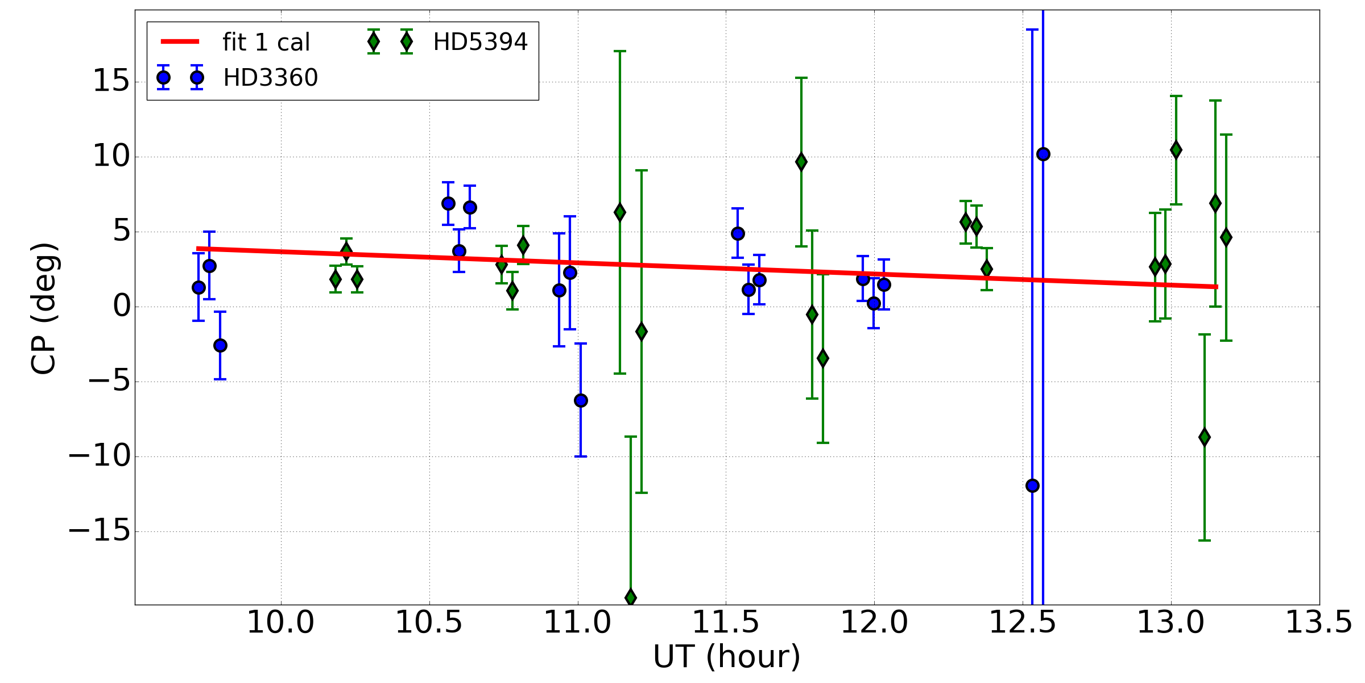
Zoom CP 09/29

Slide 19
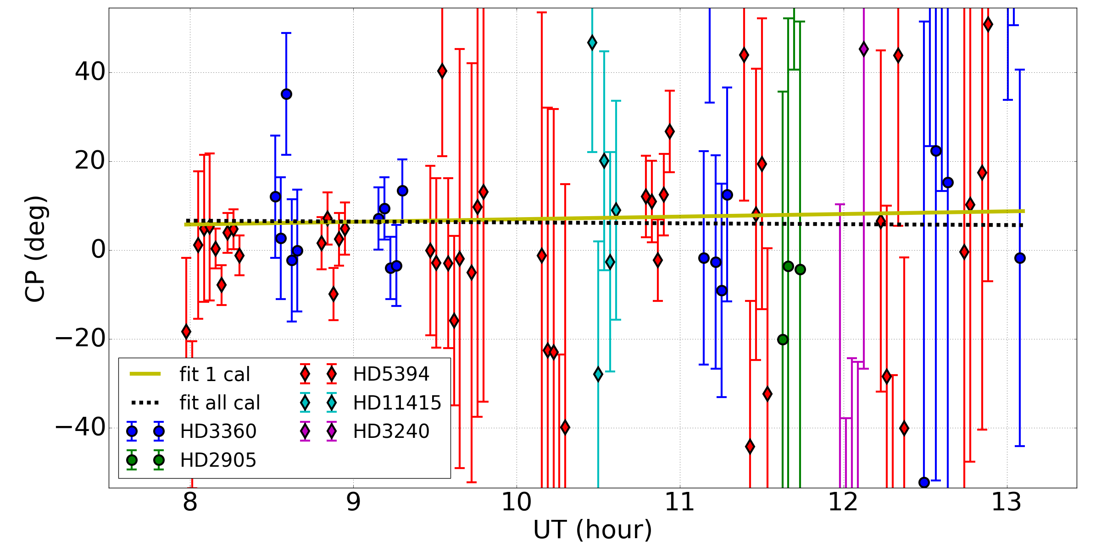
Zoom CP 09/30

Slide 20
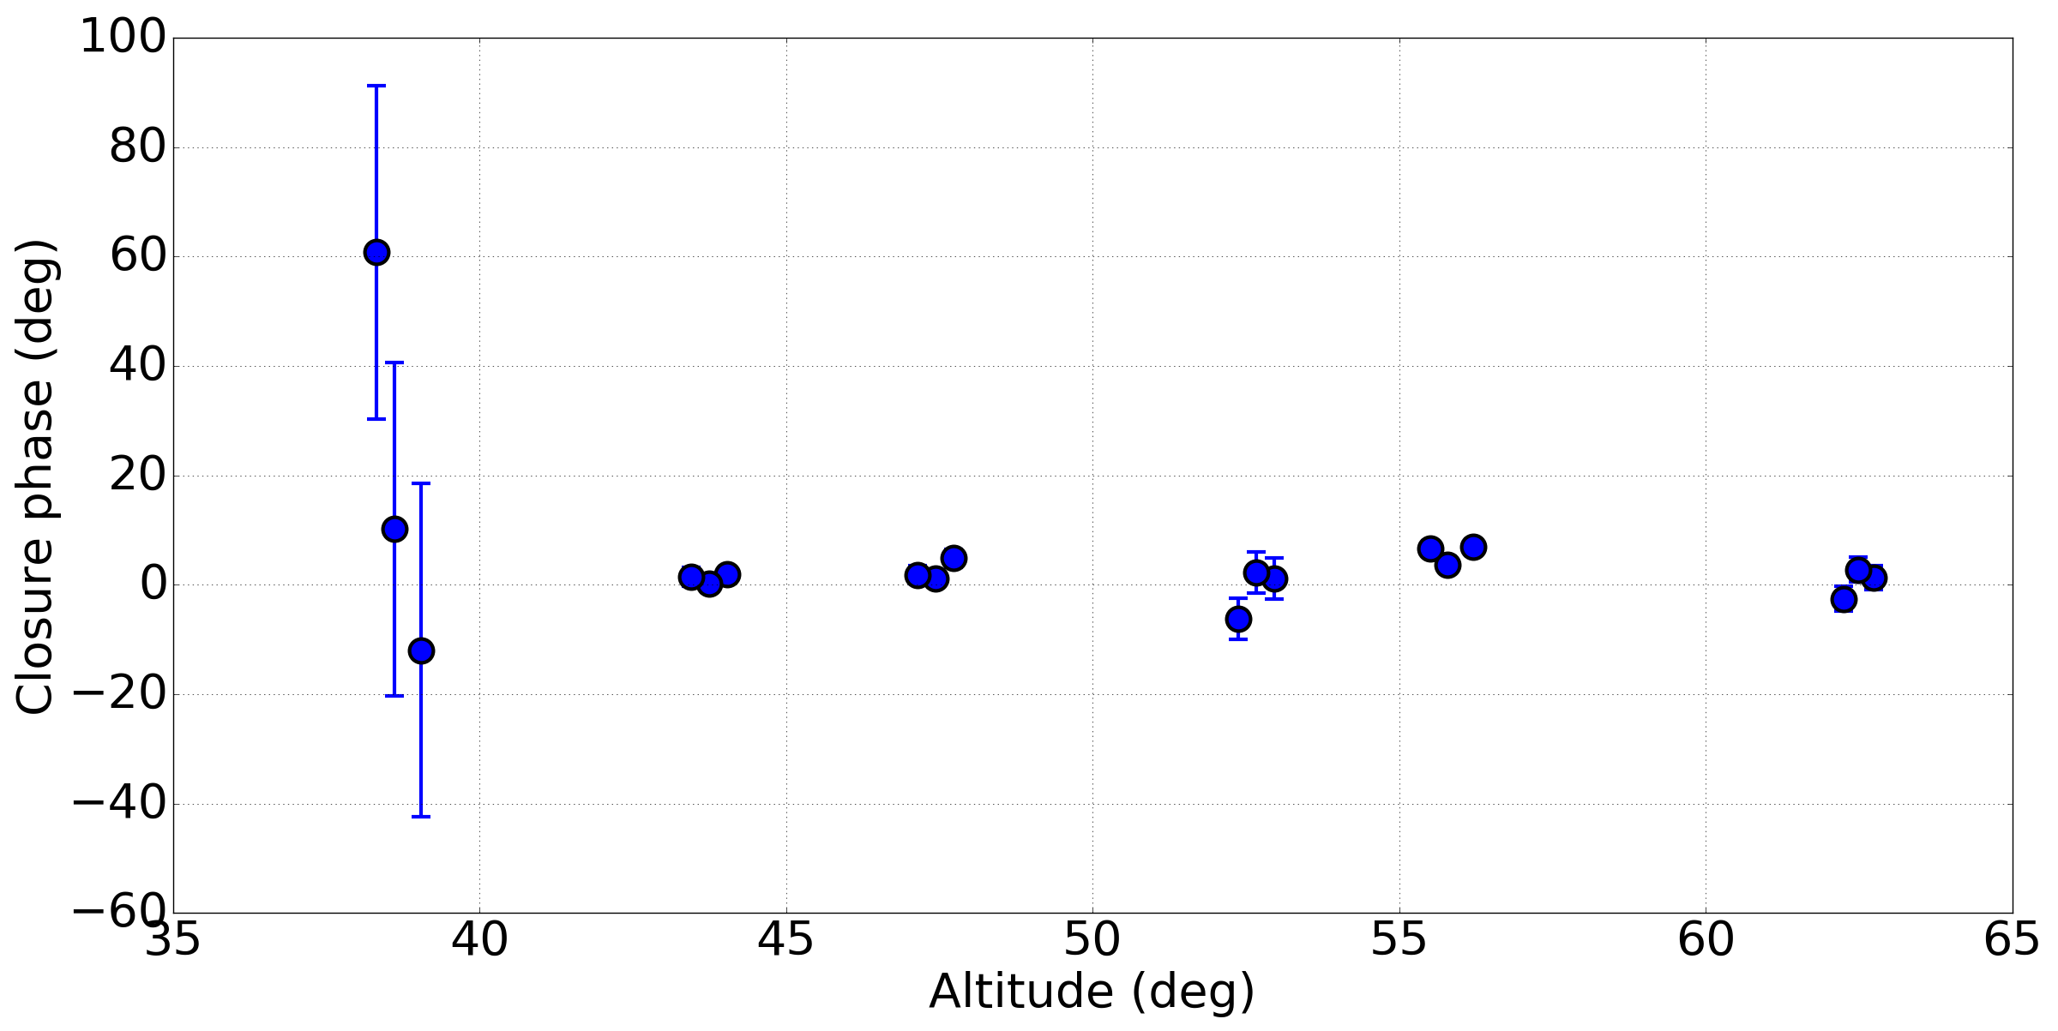
Bias CP

Slide 21
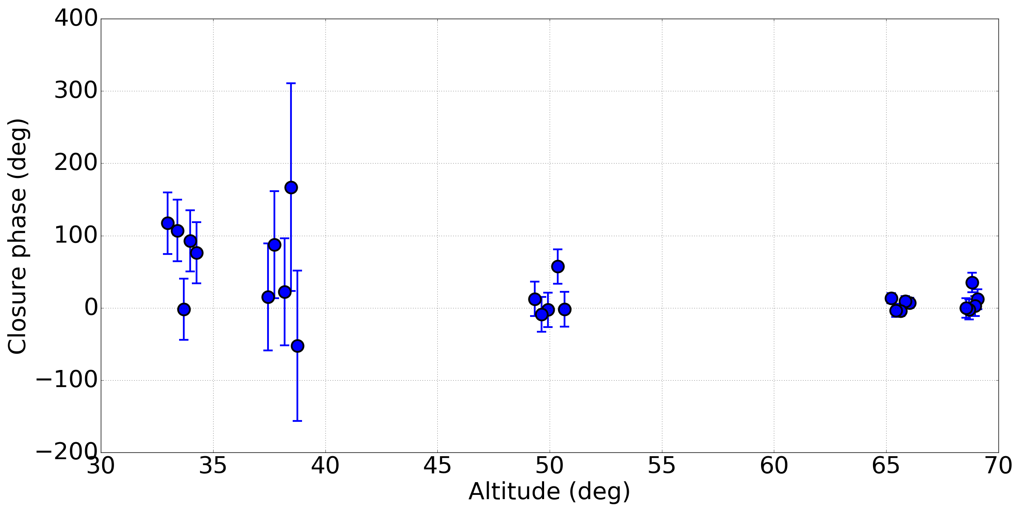
Bias CP

