Slide 1
Influence of magnetic instabilities on collisionless plasma turbulence
D. Borgogno¹, D. Grasso¹, M. Romé², L. Comisso³
⁽¹⁾ Dipartimento di Energia, Politecnico di Torino, Italy
⁽²⁾ Dipartimento di Fisica, Università degli Studi di Milano and INFN Sezione di Milano, Italy
⁽³⁾ Department of Astronomy and Columbia Astrophysics Laboratory, Columbia University, New York, USA

Slide 2
Introduction
In ideal magnetized plasmas, sheet-like field discontinuities, where current and vorticity peak, naturally form
These layers undergo fluid and magnetic instabilities whose strength depends on the amplitude of the local magnetic field and flow
The competition among magnetic reconnection (MR) and Kelvin-Helmholtz (KH) instabilities affects not only the evolution of the current sheets, that may generate plasmoid chains or KH-driven vortices, but also the energy cascade, that is different for the magnetic and kinetic spectra.

Slide 3
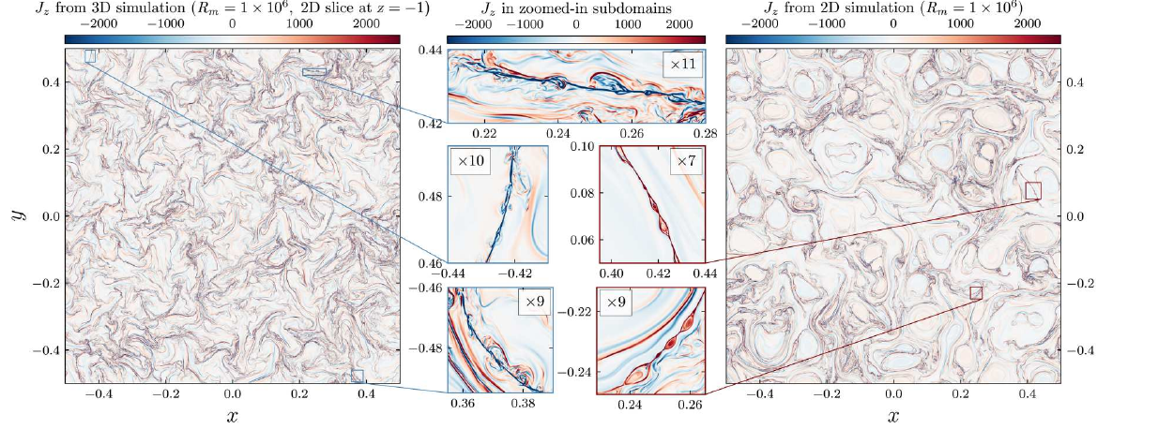
Many works have analyzed the turbulent cascade in resistive MHD, defining under which conditions the plasmoid instability influences the energy cascade
3D
2D
Dong et al. Sci. Adv. 8 2022

Slide 4
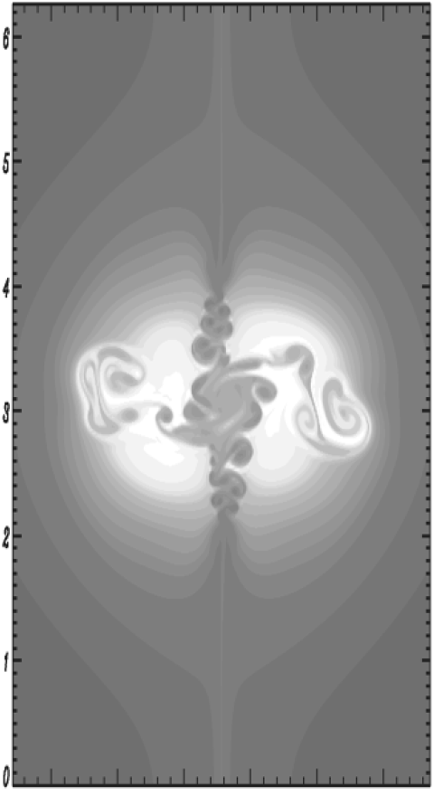
Most of the space and astrophysical plasmas are collisionless. MMS data have provided information on local kinetic-scale plasma dynamics in near-Earth space. Solar Orbiter gives information on the subinertial range spectra in the solar corona plasma
KH is expected to significantly affect MR in collisionless regimes
Del Sarto et al., Phys. Rev. Lett. 2003
Borgogno et al., Phys. Plasmas 2020

Slide 5
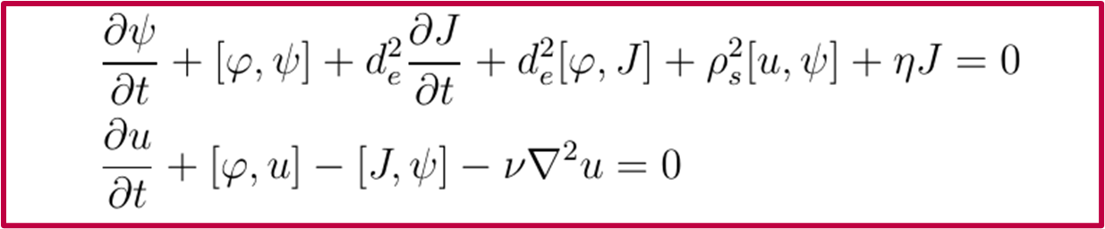









Model equations
Two fluid model, 2D
Numerical solver: SCOPE3D, pseudospectral, explicit time advancing, MPI parallelized code
Grasso et al., Plasma Phys. Controlled Fus. 1999
current density
vorticity
magnetic field $\left|B_{0}≫1\right|$
velocity
$$ρ_{S}=\sqrt{{T_{e}m_{i}c^{2}}/{e^{2}B_{0}^{2}}}$$
ion sound
Larmor radius
resistivity
viscosity
electron skin depth

Slide 6
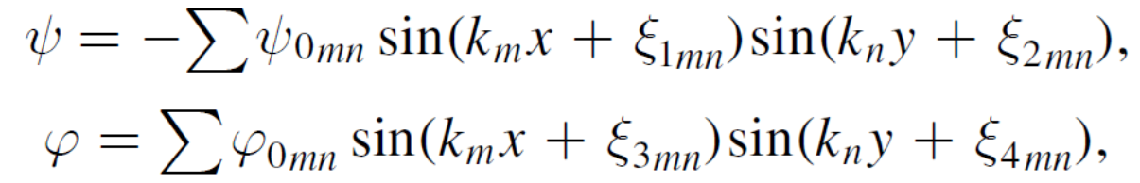

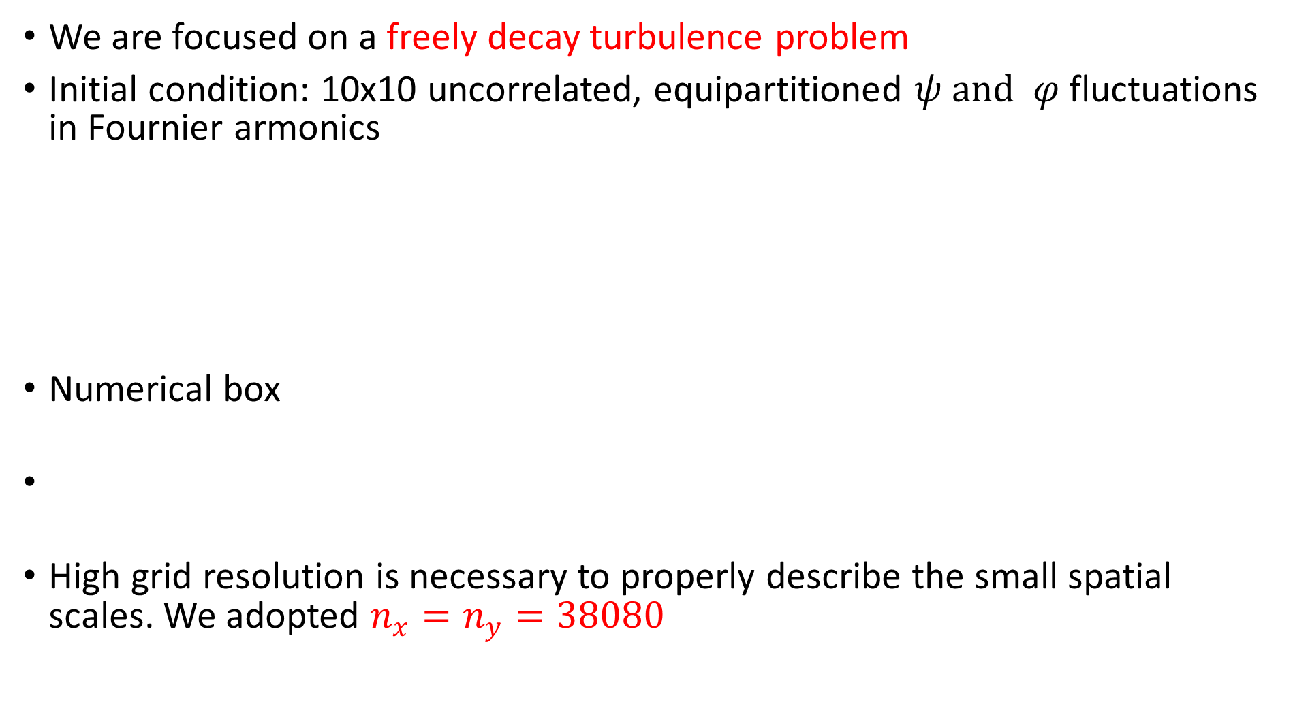
Numerical setup
We are focused on a freely decay turbulence problem
Initial condition: 10x10 uncorrelated, equipartitioned $ψ and φ$fluctuations in Fournier armonics
Numerical box
High grid resolution is necessary to properly describe the small spatial scales. We adopted $n_{x}=n_{y}=38080$
$$ρ_{S}=0$$

Slide 7
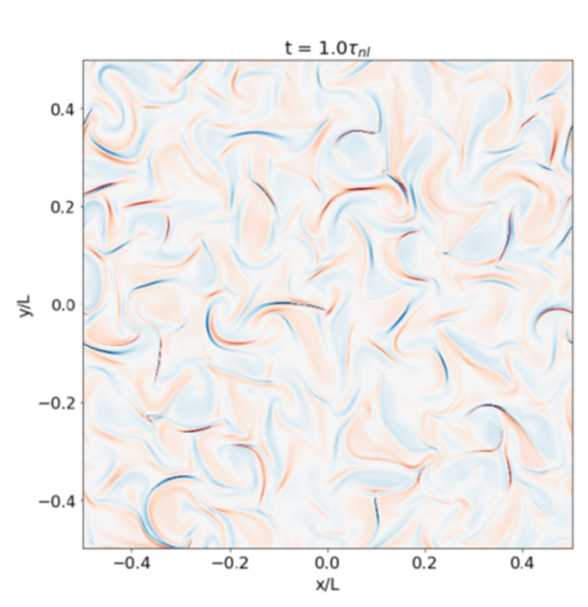
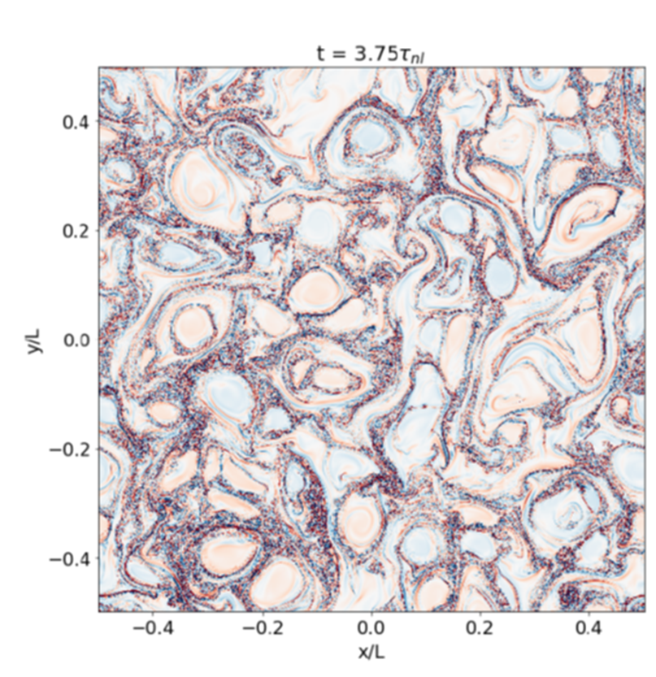

Numerical results – Current sheet evolution
The early MHD dynamics leads to the formation of thin and elongated current (and vorticity) sheets (magnetized jets) with aspect ratio $l/δ\sim l/{d_{e}}\sim 200$
Macroscopic turbulent regions appear due to the current sheets (CS) disruption, via plasmoid or KH instability
Borgogno et al. ApJ 2022

Slide 8
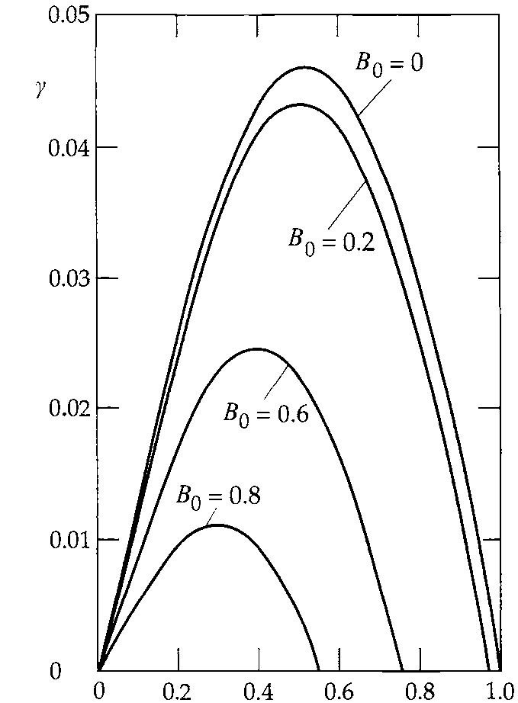


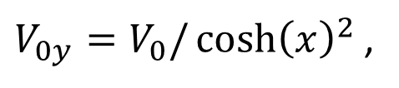

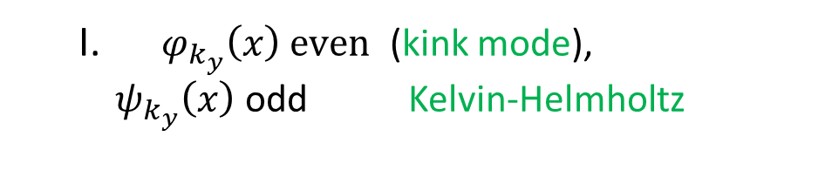
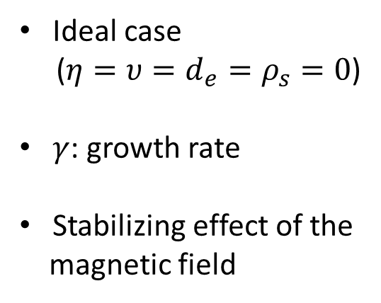
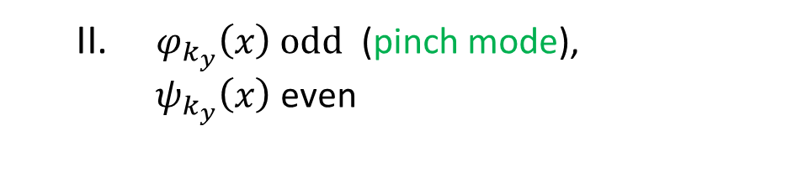


Linear stability analysis of a magnetized jet
Standard mathematical model for a magnetized jet:
The linearized equations of our model equations has two classes of eigenmodes:
$V_{0y}=V_{0}/{\cosh\left(x\right)}^{2}$ ,
$$B_{0y}=B_{0}\tanh\left(x\right)$$
  $φ_{k_{y}}\left(x\right) even$ (kink mode),
  $ψ_{k_{y}}\left(x\right)$ odd Kelvin-Helmholtz
  $φ_{k_{y}}\left(x\right) odd$ (pinch mode),
  $ψ_{k_{y}}\left(x\right)$ even
$$γ$$
$$γ$$
Ideal case
($η=υ=d_{e}=ρ_{s}=0$)
$γ$: growth rate
Stabilizing effect of the
magnetic field
$$k_{y}$$
$$k_{y}$$
D. Biskamp, Magnetic reconnection

Slide 9
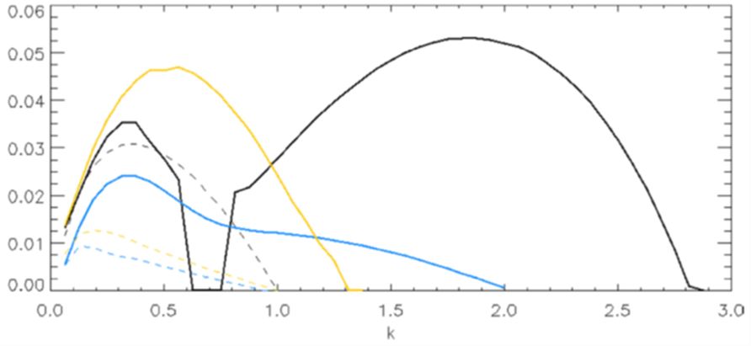


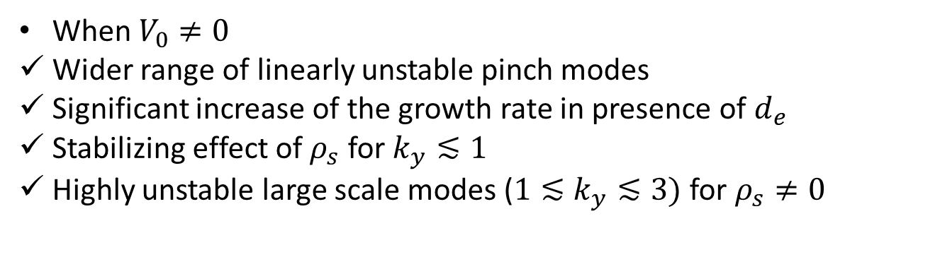


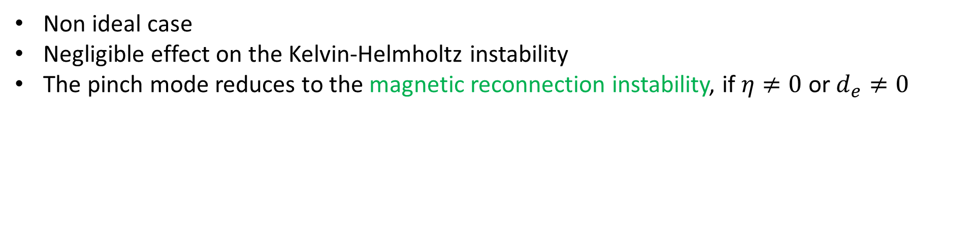
Linear stability analysis of a magnetized jet
Non ideal case
Negligible effect on the Kelvin-Helmholtz instability
The pinch mode reduces to the magnetic reconnection instability, if $η≠0$ or $d_{e}≠0$
------- $V_{0}=0, B_{0}=0.8, η≠0, d_{e}=0, ρ_{S}=0$
------- $V_{0}=0, B_{0}=0.8, η=0, d_{e}≠0, ρ_{S}=0$
------- $V_{0}=0, B_{0}=0.8, η=0, d_{e}≠0, ρ_{S}≠0$
$V_{0}≠0, B_{0}=0.8, η≠0, d_{e}=0, ρ_{S}=0$
$${ V}_{0}≠0, B_{0}=0.8, η=0, d_{e}≠0, ρ_{S}=0$$
${ V}_{0}≠0, B_{0}=0.8, η=0, d_{e}≠0, ρ_{S}≠0$
$$γ$$
$$k_{y}$$
When $V_{0}≠0$
Wider range of linearly unstable pinch modes
Significant increase of the growth rate in presence of $d_{e}$
Stabilizing effect of $ρ_{s}$ for $k_{y}≲1$
Highly unstable large scale modes (${1≲k}_{y}≲3)$ for $ρ_{s}≠0$
Grasso & Borgogno, Plasma Modelling, IOP 2022

Slide 10
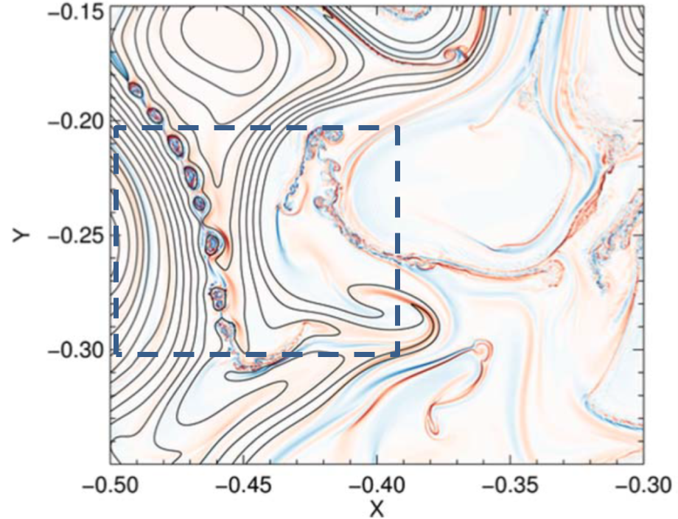
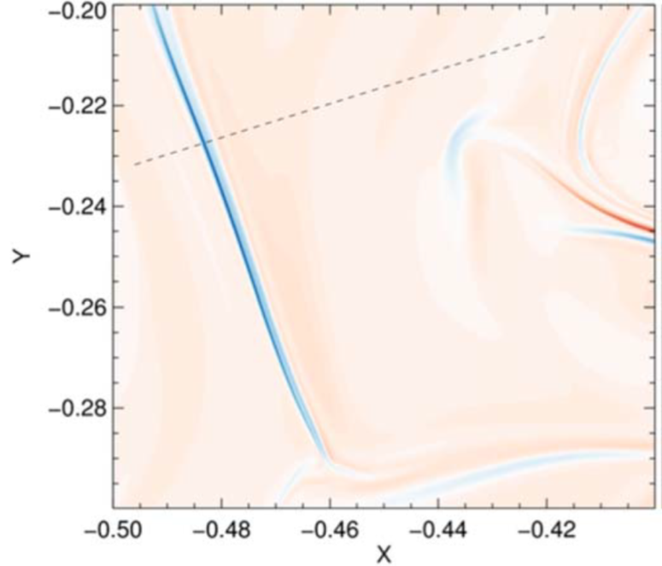
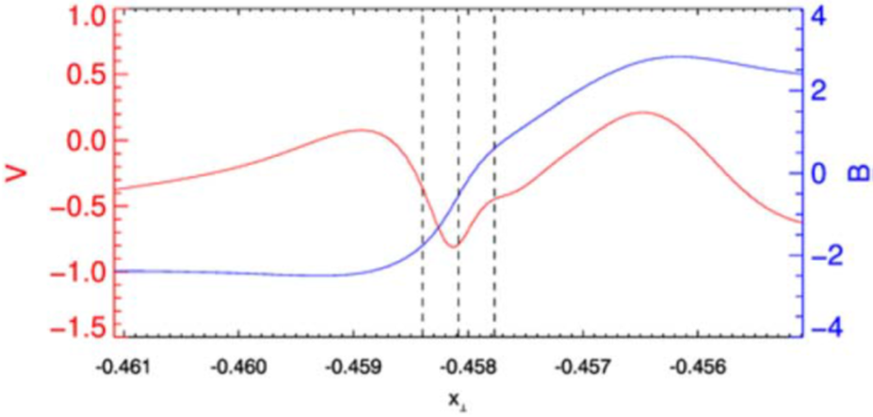
CS disruption – Plasmoid instability (1)
Magnetic field larger than velocity inside the layer.
KH stabilization and MR onset.

Slide 11
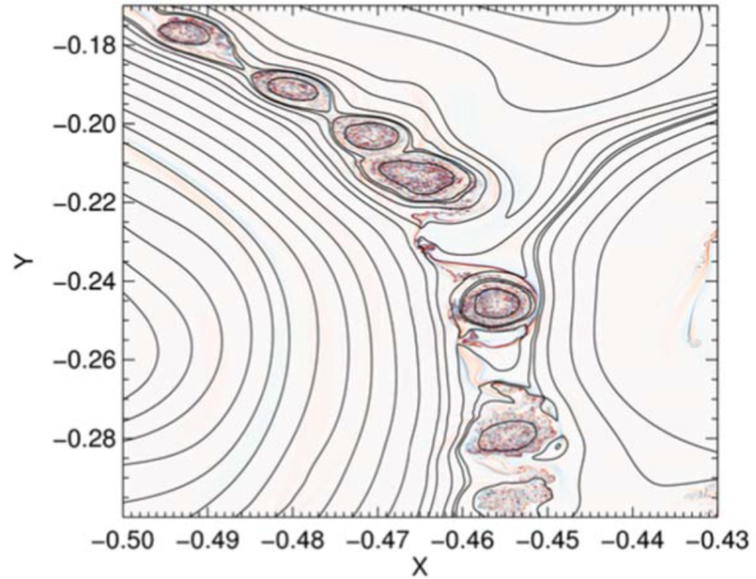
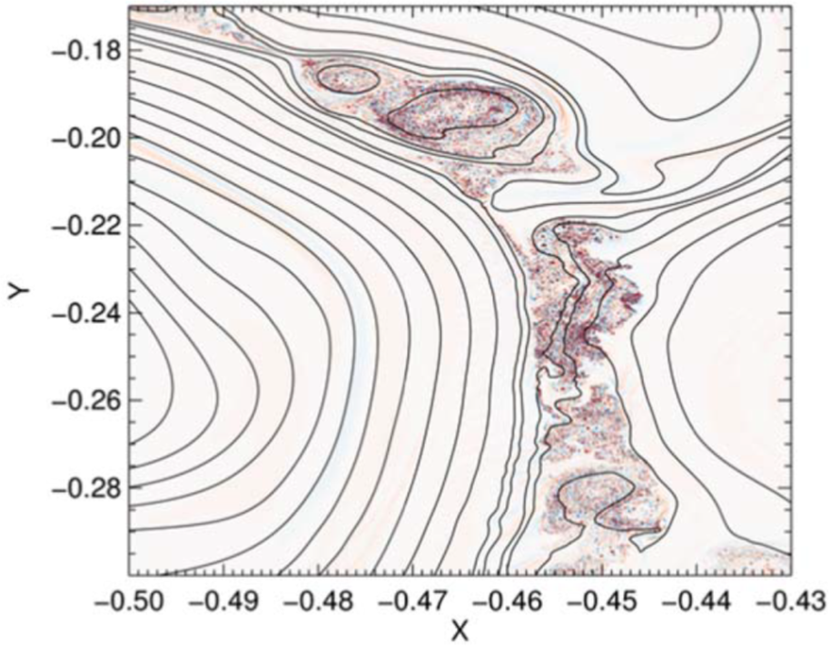
CS disruption – Plasmoid instability (2)
In the early stage of the plasmoid instability, turbulence is confined inside the magnetic structures. Typical feature of the laminar magnetic reconnection in low electron temperature, collisionless regimes
Coalescence between the magnetic structures that belong
to the same island chain results in larger turbulent regions
where the magnetic structures eventually disappear.
The magnetic connections between the nearby turbulent
regions finally drive the appearance of macroscopic turbulent domains

Slide 12
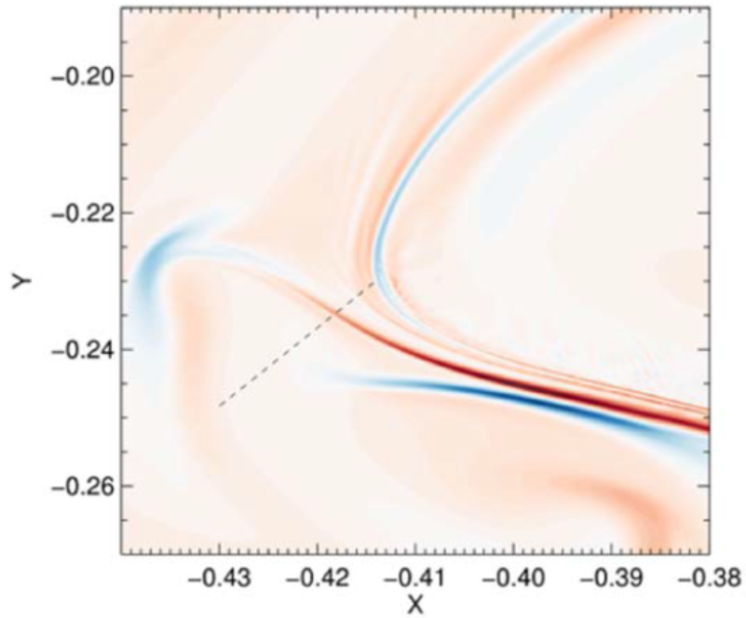
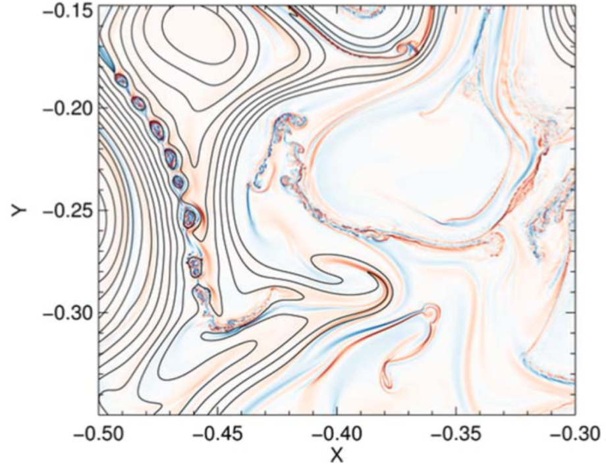

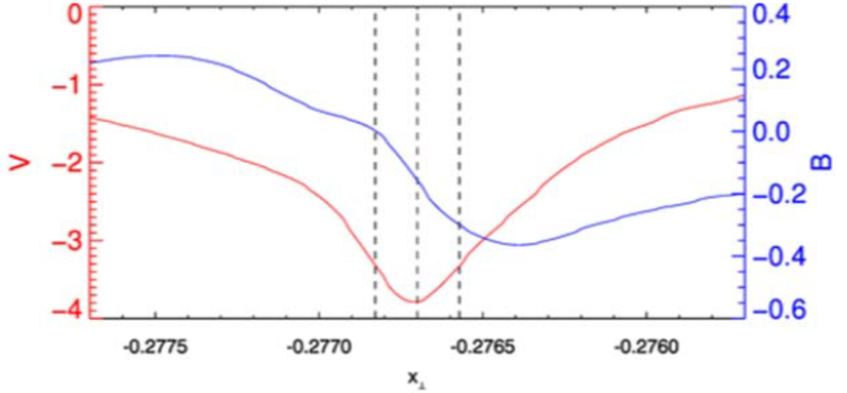
CS disruption. KH instability
Weak magnetic field in the region dominated by KH
Large flow inside the CS prevents the MR onset

Slide 13
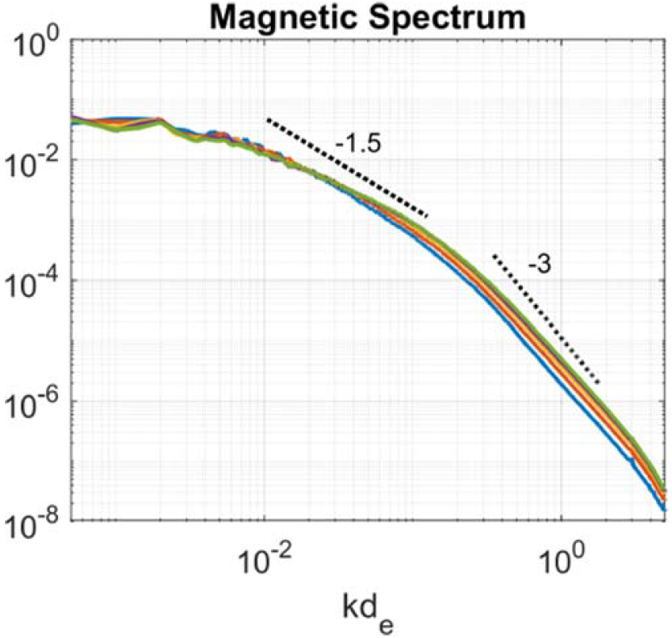
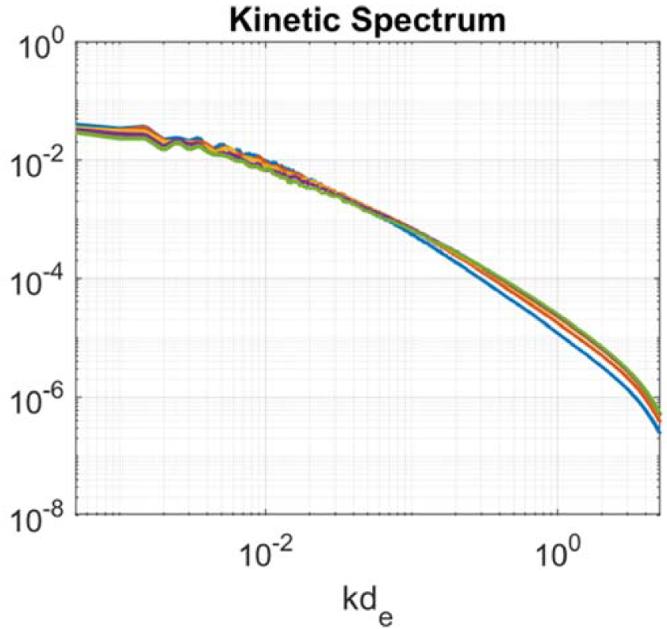
Energy spectra
Magnetic energy spectrum at four times, after the
plasmoid formation
Change in the slope of the magnetic energy spectrum at
kd_{e} ∼ 0.1, which corresponds to plasmoids of size
w_{pl} ∼ 0.1l_{cs} ∼ 20d_{e}
Smoother slopes than theoretical predictions
The magnetic energy spectrum tends to flatten, consistently
with the observation that the fully plasmoid mediated regime
is somehow inhibited by the presence of a turbulence
dominated by the KH instability
Kinetic spectrum decoupled from the magnetic one
No evidence of exponential decay

Slide 14
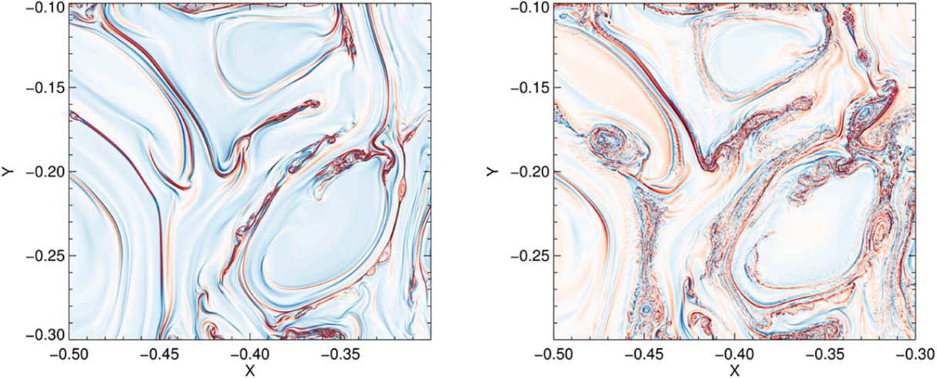


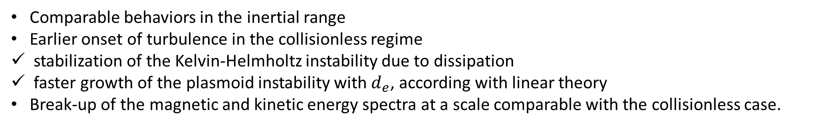
Collisionless vs resistive
$$η=5∙{10}^{−6}, { d}_{e}=0$$
$$η=0, { d}_{e}=5∙{10}^{−4}$$
Comparable behaviors in the inertial range
Earlier onset of turbulence in the collisionless regime
stabilization of the Kelvin-Helmholtz instability due to dissipation
faster growth of the plasmoid instability with $d_{e}$, according with linear theory
Break-up of the magnetic and kinetic energy spectra at a scale comparable with the collisionless case.

Slide 15
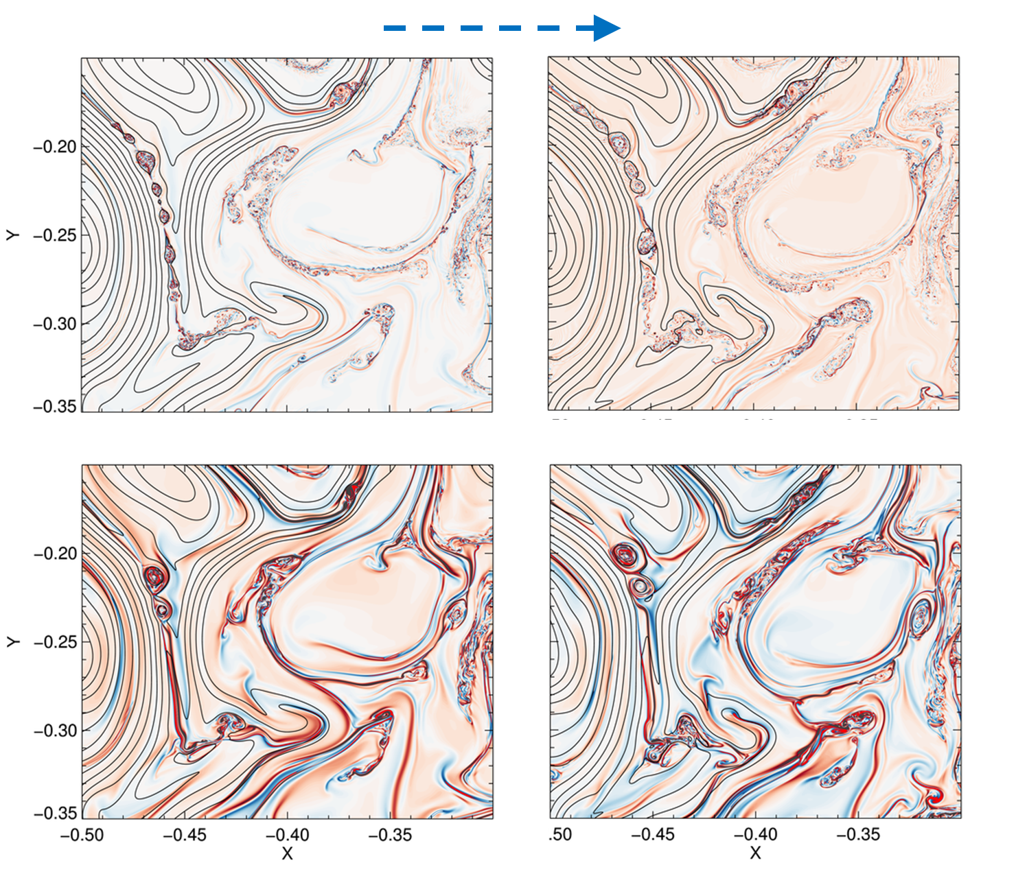
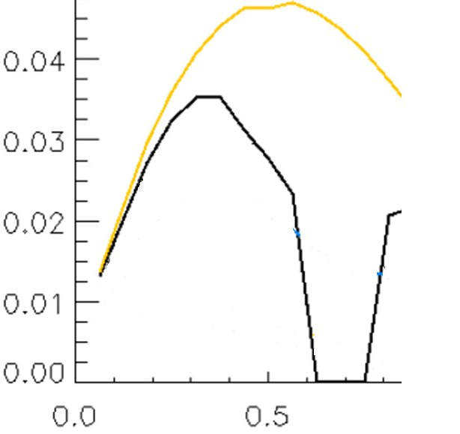






Electron temperature effect ($ρ_{s}≠0$)
time
Stabilization of plasmoid instability for large wavelength
modes in agreement with linear theory
$$ρ_{s}=0$$
$$γ$$
$$d_{e}≠0, ρ_{S}=0$$
$$d_{e}≠0, ρ_{S}≠0$$
$$ρ_{s}=d_{e}$$
plasmoid wavelength
range
$$k∙δ$$
$δ\sim d_{e}$ current sheet width

Slide 16
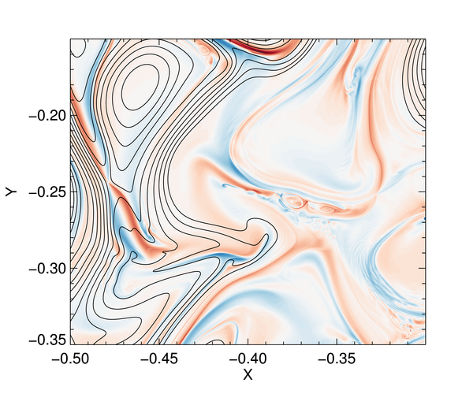
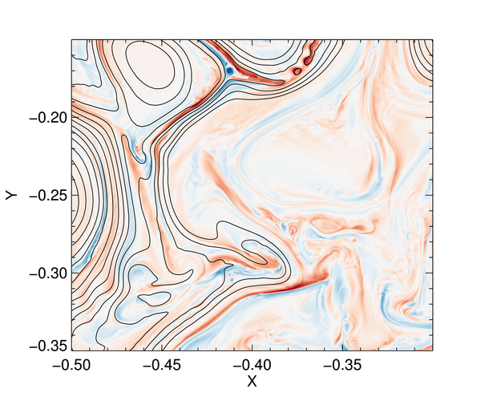
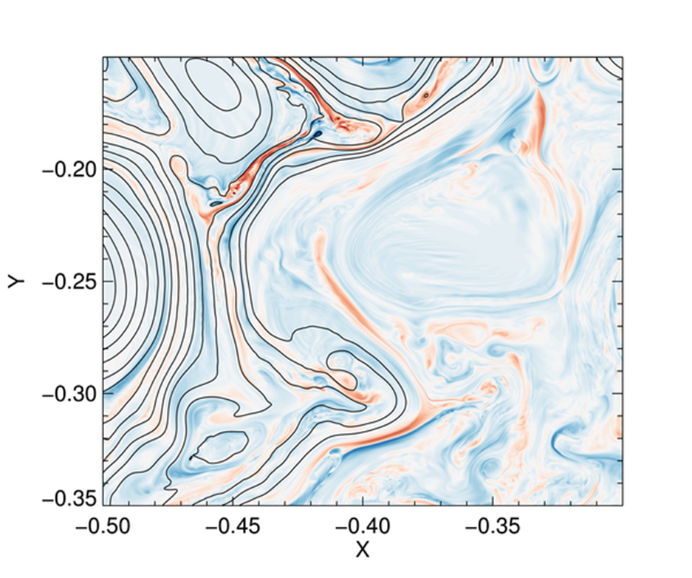
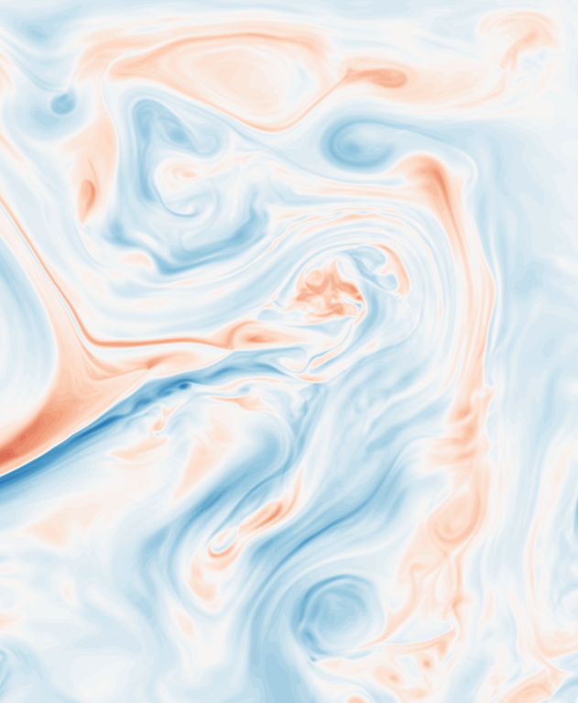
Electron temperature effect ($ρ_{s}≠0$)
$$ρ_{s}>d_{e}$$
time
Current layers with a cross-shape structure flow and magnetic field are not aligned
Larger fluid scales generated by KH

Slide 17
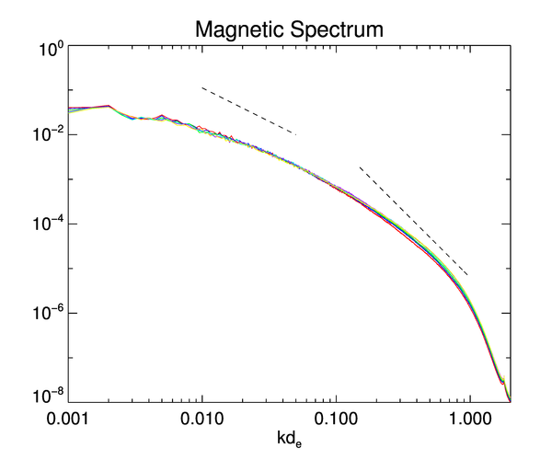
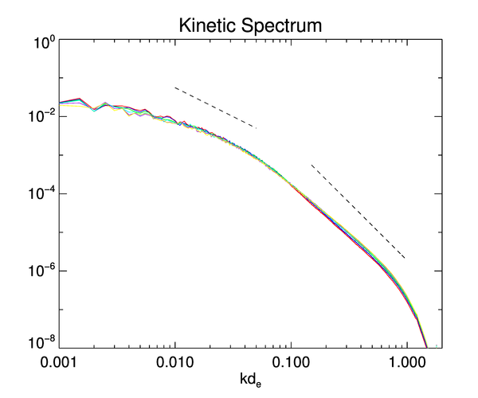

Electron temperature effect ($ρ_{s}≠0$)
$$ρ_{s}>d_{e}$$
-1.5
-1.5
In this regime MR does not affect the energy transfert across scales
Electron temperature is responsible for the breakup of the turbulent kinetic energy spectrum at $kρ_{s}\sim 0.3$
-3
-3

Slide 18

Conclusions
We addressed the problem of turbulent cascade in the collisionless regime focusing on the interaction between the magnetic and fluid instabilities
In cold electron plasmas:
  plasmoid instability causes the steepening of the magnetic energy spectrum for the range $k>{0.1}/{d_{e}}$
  plasmoid instability is enhanced by the presence of sheared flows
In hot electron plasmas:
stabilization of magnetic reconnection
Steepening of the kinetic energy spectrum in the subinertial range
Are plasmoids really necessary to correctly describe turbulence in
space observations and laboratory experiments?

Slide 19
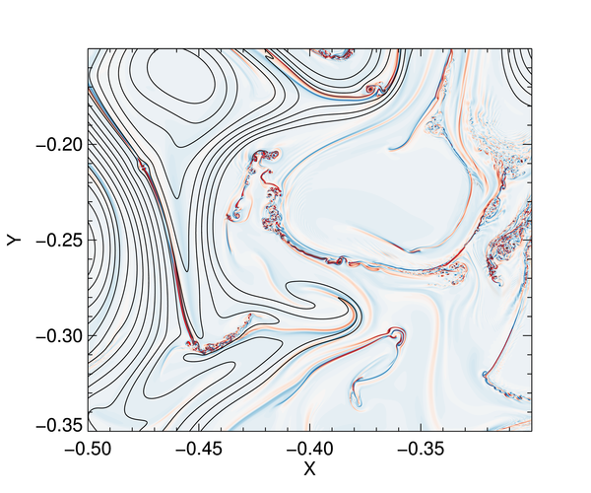
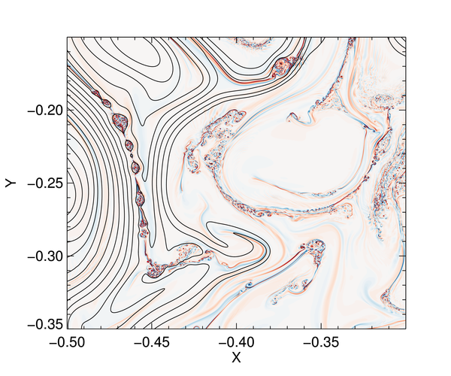
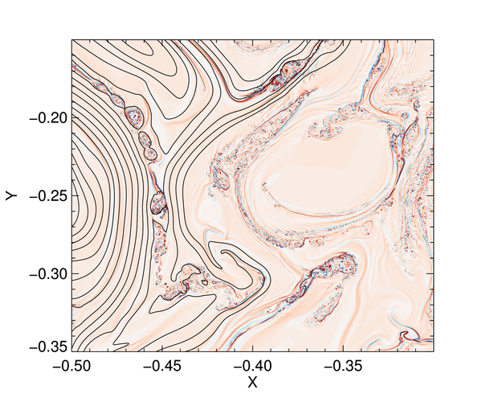
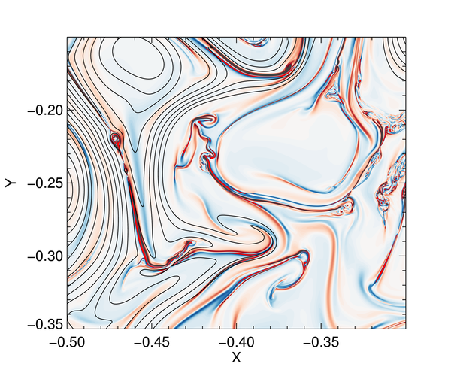
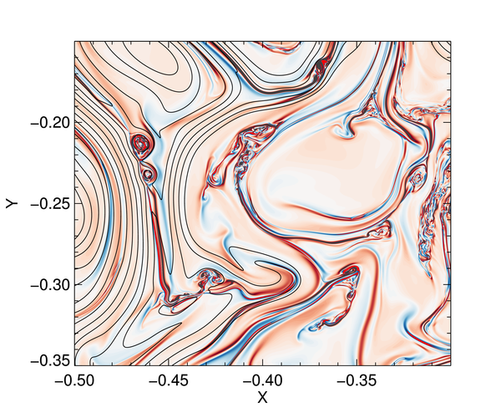
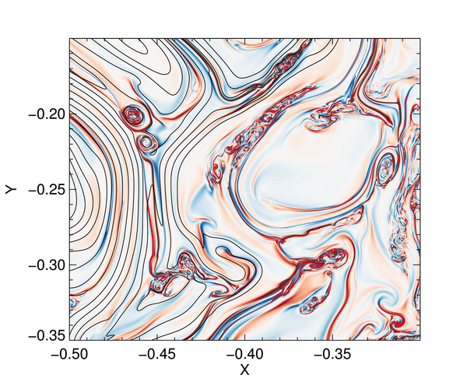
Electron temperature effect ($ρ_{s}≠0$)
time
$$ρ_{s}=0$$
$$ρ_{s}=d_{e}$$

